Slide 1
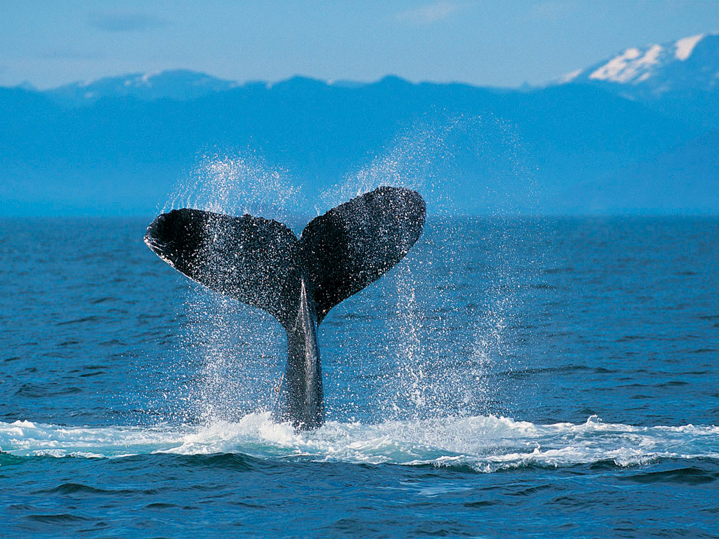

Catholic University College of Ghana
Introduction to Information Technology II (Internet)
Catholic University College of Ghana
Fiapre-Sunyani

Slide 2
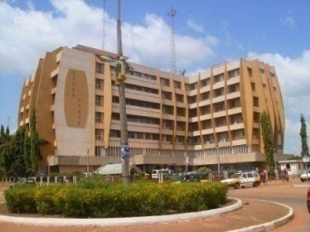
Facilitator Information
Audrey Asante
  Tutor, Faculty of Information and Communication Sciences and Technology
Email: aasante@cug.edu.gh
Telephone: 0265302718

Slide 3
Course Objectives and Learning outcomes
Upon completion of this course, students should have
  Known the concepts behind Internet technology
  Understood the benefits gained through the use of the internet
  Hands on experience in designing their own websites.
  Known the services of the internet

Slide 4
Study Material
Primary Source
  Raymond Greenlaw, Ellen Hepp (1999), In-line/On-line: Fundamentals of the Internet and the World Wide Web, McGraw Hills Company
Secondary Source
  Brian K. Williams, Stacey C. Sawyer, Sarah E. Hutchinson (1999), Using Information Technology, 3rd Edition, McGraw

Slide 5
Where do I get help?
Academic Journals (Google Scholar)
Websites
Notes
Tutor
Class Discussions

Slide 6
Assessment Criteria
Continuous Assessment Mark
  2 unannounced tests - 15 marks
  (Test 1: 10 marks; Test 2: 5 marks)
  Attendance - 5 marks
  Mini Project - 20 marks
Examination
  Written Exam (date & time to be confirmed)
Final Mark
  40% of Continuous Assessment Mark + 60% Examination Mark

Slide 7
List of Topics
    Online Information Services and Bulleting Board Services (BBS)
An introduction to Internet
    history and the changing world
Internet Architecture
Terminologies associated with Internet technologies
  Domain,
  ISP
  Client-Server computing,
  transport medium
  Telephone modems, Ethernet, ISDN, cable modems, DSL, ADSL, VLAN
Surfing the Net
Internet Etiquette (Netiquette)

Slide 8
List of Topics
Features and tools for navigating available on the Internet: Services of the Internet
    electronic mail,
    network news/newsgroup,
    gopher
    faxes and files (FTP);
    remote login and remote desktops (Telnet),
    Internet relay chat (IRC)
Electronic commerce and business;
Hand on experience on website and pages, Web browsers and browsing examples of websites and services

Slide 9
List of Topics
Creating Web pages
    Web page creation strategies
    How Html works
    Publishing files on the WWW
    Database Design
      Microsoft Access
      SQL, MYSQL
    worldwide document
      Introduction to FrontPage, Dreamweaver, PHP
    Internet Security :facilities for secure communication

Slide 10
List of Topics
    Search Tools and Search Engines
  Searching for Information and common found internet file types
Downloading from the internet and bibliographic style of citing internet resources
Societal Issues and Emerging Technology

Slide 11
List of Topics
  Microsoft Excel
Microsoft PowerPoint

