Slide 1
Network Layer

Slide 2
The Network Layer
Layer 3 on the OSI reference model
The layer at which routing occurs
Responds to service requests from the transport layer and issues service requests to the data link layer.

Slide 3
Network Layer
Concerned with getting packets from source to destination.
The network layer must know the topology of the subnet and choose appropriate paths through it.
When source and destination are in different networks, the network layer (IP) must deal with these differences.
Key issue: what service does the network layer provide to the transport layer (connection-oriented or connectionless).

Slide 4
Network Layer Design Goals
The services provided by the network layer should be independent of the subnet topology.
The Transport Layer should be shielded from the number, type and topology of the subnets present.
The network addresses available to the Transport Layer should use a uniform numbering plan (even across LANs and WANs).

Slide 5
Network Layer
OSI Model
Implements routing of frames (packets) through the network.
Defines the most optimum path the packet should take from the source to the destination
Defines logical addressing so that any endpoint can be identified.
Handles congestion in the network.
Facilitates interconnection between heterogeneous networks (Internetworking).
The network layer also defines how to fragment a packet into smaller packets to accommodate different media.

Slide 6
Functions
Logical addressing
Routing
flow control
segmentation
error control functions

Slide 7
Network Layer
The Network layer is responsible for the source-to-destination delivery of a packet possible across multiple networks.
The network layer is responsible for the source-to-destination (computer-to-computer or host-to-host) delivery of a packet, possibly across multiple networks (links). The network layer ensures that each packet gets from its point of origin to its final destination.
If two systems are connected to the same link, there is usually no need for a network layer. However, if the two systems are attached to different networks, there is often a need for the network layer to accomplish source-to-destination delivery.

Slide 8
Logical addressing. The physical addressing implemented by the data link layer handles the addressing problem locally.
The network layer adds a header to the packet coming from the upper layer, among other things, includes the logical address of the sender and receiver.
Routing. When independent networks or links are connected together to create an internetwork (a network of networks) or a large network, the connecting devices (called routers or gateways) route or switch the packets to their final destination.

Slide 9
Router
A router consists of a computer networking device that determines the next network point to which a data packet has to be forwarded on its way to its destination

Slide 10
Routing
The network layer has a specific duty: routing. Routing means determination of the partial or total path of a packet. As the Internet is a collection of networks (LANs, WANs, and MANs), the delivery of a packet from its source to its destination may be a combination of several deliveries: a source-to-router delivery, several router-to-router delivery, and finally a router-to-destination delivery.

Slide 11
Routers
A router is connected to at least two networks.
A router creates and/or maintains a table, called a "routing table" that stores the best routes to network destinations.

Slide 12
Routers
Routing is most commonly associated with the Internet Protocol, although other less-popular routed protocols continue in use.

Slide 13
Packet Switching
Refers to protocols in which messages are divided into packets before they are sent.
Each packet is then transmitted individually and can even follow different routes to its destination.
Once all the packets forming a message arrive at the destination, they are recompiled into the original message.

Slide 14
Virtual circuits
A connection between two devices that acts as though it's a direct connection even though it may physically be circuitous.
The term is used most frequently to describe connections between two hosts in a packet-switching network

Slide 15
Switch
A device that filters and forwards packets between LAN segments.
Switches operate at the data link layer (layer 2) and sometimes the network layer (layer 3) of the OSI model and therefore support any packet protocol.

Slide 16
IPv4
IPv4 is version 4 of IP. It was the first version of the Internet Protocol to be widely deployed, and forms the basis for the current (as of 2004) Internet.
As the number of addresses available is consumed, an IPv4 address shortage appears to be inevitable in the long run.

Slide 17
IPv6
IPv6 is version 6 of the Internet Protocol. IPv6 is intended to replace the previous standard, IPv4

Slide 18
IPv6
IPv6 is the second version of the Internet Protocol to be widely deployed, and is expected to form the basis for future expansion of the Internet.
The compelling reason behind the formation of IPv6 was lack of address space, especially in the heavily populated countries of Asia such as India and China.

Slide 19
IPv6
IPv6 addresses are 128 bits long normally written as eight groups of 4 hexadecimal digits each.
  For example,
3ffe:6a88:85a3:08d3:1319:8a2e:0370:7344
2001:0db8:85a3:08d3:1319:8a2e:0370:7334

Slide 20
Routable and Nonroutable Protocols within the Network Layer
An important difference between protocols is their ability to be routed.
A protocol that is routable can have packets transferred across a router.
Routable protocols require additional information be included in the packet header for routing purposes; for example, a time to live field (TTL)

Slide 21
TCP/IP
TCP/IP (Transmission Control Protocol/Internet Protocol) is the most common protocol used today.
TCP/IP, a routable protocol, is very robust and is commonly associated with UNIX systems.
TCP/IP was originally designed in the 1970s to be used by the Defense Advanced Research Projects Agency (DARPA) and the Department of Defense (DOD) to connect systems across the country.

Slide 22
TCP/IP
Only IP of the TCP/IP protocol resides in the Network Layer.
The TCP portion of the protocol is part of the Transport Layer
TCP is connection oriented
IP is connectionless

Slide 23
IPX/SPX
IPX/SPX (Internetwork Packet Exchange/Sequenced Packet Exchange) is the protocol most commonly used with Novell NetWare.
IPX/SPX, a routable protocol, is a very fast and highly established protocol, but it is not used on the Internet.
The protocol IPX/SPX/NWLink was written by Microsoft and is fully compatible with the Novell protocol.

Slide 24
IPX/SPX
Only IPX of the IPX/SPX protocol resides in the Network Layer.
The SPX portion of the protocol is part of the Transport Layer.

Slide 25
AppleTalk
AppleTalk is the proprietary protocol developed by Apple Computer.
AppleTalk is rarely found in network environments where Apple Computers are not present.
AppleTalk is a routable protocol.

Slide 26
NetBEUI
NetBEUI (NetBIOS Extended User Interface) is a transport protocol commonly found in smaller networks.
NetBEUI will become less used in the future because it is not a routable protocol.
NetBEUI is an extremely quick protocol with little overhead because of its inability to route packets.
NetBEUI is also very easy to configure

Slide 27
Static and Dynamic Routing
Static routing consists of adding, maintaining, and deleting routes of the network routing devices by the network administrator.
Early routers had to be programmed with exactly which networks they could route between which interfaces, especially if there were many network interfaces.
For medium to large networks, this can be nearly impossible.

Slide 28
Dynamic routing
Dynamic routing does not require the network administrator to edit complex routing tables in order to communicate with other networks or segments.
These routers communicate with each other using a powerful routing protocol such as Routing Information Protocol (RIP) or Open Shortest Path First (OSPF).

Slide 29
Comparing Static and Dynamic Routing
With just two networks, the static routing setup is the more appropriate.
If your network has several parallel networks, dynamic routing would be easier to set up.

Slide 30
Default Gateways
The default gateway is specified on each computer, and sends the packet to the first router.
When the packet hits this first router, the router must determine if the destination computer is on the local network, or send the packet to the next router that will get the packet to its destination.

Slide 31
Routing
Routing algorithm:: that part of the Network Layer responsible for deciding on which output line to transmit an incoming packet.
Remember: For virtual circuit subnets the routing decision is made ONLY at set up.
Algorithm properties:: correctness, simplicity, robustness, stability, fairness, optimality, and scalability.

Slide 32
Routing Classification
Adaptive Routing
based on current measurements
of traffic and/or topology.
1. centralized
2. isolated
3. distributed
Non-Adaptive Routing
routing computed in advance and off-line
flooding
static routing using shortest path algorithms

Slide 33
7 Application
OVERVIEW
Routing Algorithms
  Shortest Path
  Flooding
  Flow-based
  Distance Vector
  Link State
  Hierarchical
  Broadcast
  Multicast
  Routing for Mobile Hosts
Congestion control
IP Addressing
Routers
6 Presentation
5 Session
4 Transport
3 Network
2 Data Link
1 Physical

Slide 34
Shortest Path Routing
Bellman-Ford Algorithm [Distance Vector]
Dijkstra’s Algorithm [Link State]
What does it mean to be the shortest (or optimal) route?
Choices:
Minimize the number of hops along the path.
Minimize mean packet delay.
Maximize the network throughput.

Slide 35
7 Application
ROUTING ALGORITHMS
1. Shortest Path
6 Presentation
B(A,2)
C(B,3)
5 Session
B
1
C
2
4 Transport
3
2
3
A(-,-)
2
D(E,3)
A
3 Network
D
F(E,4)
1
1
F
2 Data Link
2
E(A,2)
2
E
1 Physical
A – E – D – F
A – E – F is the answer.

Slide 36
Dijkstra’s Shortest Path Algorithm
Initially mark all nodes (except source) with infinite distance.
working node = source node
Sink node = destination node
While the working node is not equal to the sink
1. Mark the working node as permanent.
2. Examine all adjacent nodes in turn
If the sum of label on working node plus distance from working node to adjacent node is less than current labeled distance on the adjacent node, this implies a shorter path. Relabel the distance on the adjacent node and label it with the node from which the probe was made.
3. Examine all tentative nodes (not just adjacent nodes) and mark the node with the smallest labeled value as permanent. This node becomes the new working node.
Reconstruct the path backwards from sink to source.

Slide 37
Flooding
Pure flooding :: every incoming packet to a node is sent out on every outgoing line.
  Obvious adjustment – do not send out on arriving link (assuming full-duplex links).
  The routing algorithm can use a hop counter (e.g., TTL) to dampen the flooding.
  Selective flooding :: only send on those lines going “approximately” in the right direction.

Slide 38
7 Application
ROUTING ALGORITHMS
2. Flooding
6 Presentation
5 Session
IMP
B
Packet to IMP C
Packet
Packet to IMP D
4 Transport
Packet to IMP E
To prevent packets from circulating indefinitely, a packet has a hop counter. Every time a packet arrives at an IMP, the hop counter is decrease by 1. Once the hop counter of a packet reaches 0, the packet is discarded.
3 Network
2 Data Link
1 Physical

Slide 39
Adaptive Routing
Basic functions:
Measurement of pertinent network data.
Forwarding of information to where the routing computation will be done.
Compute the routing tables.
Convert the routing table information into a routing decision and then dispatch the data packet.

Slide 40
Adaptive Routing
Design Issues:
How much overhead is incurred due to gathering the routing information and sending routing packets?
What is the time frame (i.e, the frequency) for sending routing packets in support of adaptive routing?
What is the complexity of the routing strategy?

Slide 41
Distance Vector Routing
Historically known as the old ARPANET routing algorithm {or known as Bellman-Ford algorithm}.
Basic idea: each network node maintains a Distance Vector table containing the distance between itself and ALL possible destination nodes.
Distances are based on a chosen metric and are computed using information from the neighbors’ distance vectors.
Metric: usually hops or delay

Slide 42
Distance Vector Routing
Information kept by DV router
each router has an ID
associated with each link connected to a router, there is a link cost (static or dynamic) the metric issue!
Distance Vector Table Initialization
Distance to itself = 0
Distance to ALL other routers = infinity number

Slide 43
Distance Vector Algorithm [Perlman]
Router transmits its distance vector to each of its neighbors.
Each router receives and saves the most recently received distance vector from each of its neighbors.
A router recalculates its distance vector when:
  It receives a distance vector from a neighbor containing different information than before.
  It discovers that a link to a neighbor has gone down (i.e., a topology change).
The DV calculation is based on minimizing the cost to each destination.

Slide 44
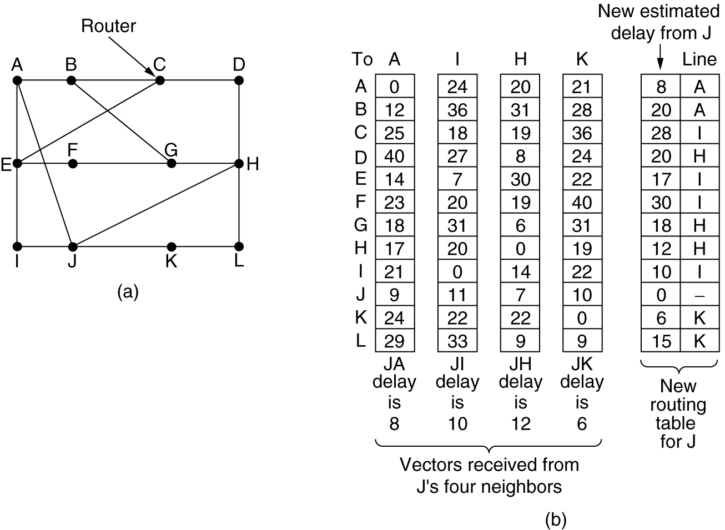
Distance Vector Routing
Figure 5-9.(a) A subnet. (b) Input from A, I, H, K, and the new routing table for J.

Slide 45
Routing Information Protocol (RIP)
RIP had widespread use because it was distributed with BSD Unix in “routed”, a router management daemon.
RIP is the most used Distance Vector protocol.
RFC1058 in June 1988.
Sends packets every 30 seconds or faster.
Runs over UDP.
Metric = hop count
BIG problem is max. hop count =16
➔ RIP limited to running on small networks!!
Upgraded to RIPv2

Slide 46
Figure 4.17 RIP Packet Format
(network_address,
distance)
pairs
P&D slide

Slide 47
Link State Algorithm
Each router is responsible for meeting its neighbors and learning their names.
Each router constructs a link state packet (LSP) which consists of a list of names and cost to reach each of its neighbors.
The LSP is transmitted to ALL other routers. Each router stores the most recently generated LSP from each other router.
Each router uses complete information on the network topology to compute the shortest path route to each destination node.

Slide 48
Figure 4.18 Reliable LSP Flooding
P&D slide

Slide 49
Reliable Flooding
The process of making sure all the nodes participating in the routing protocol get a copy of the link-state information from all the other nodes.
LSP contains:
  Sending router’s node ID
  List connected neighbors with the associated link cost to each neighbor
  Sequence number
  Time-to-live

Slide 50
Reliable Flooding
First two items enable route calculation
Last two items make process reliable
  ACKs and checking for duplicates is needed.
Periodic Hello packets used to determine the demise of a negihbor
The sequence numbers are not expected to wrap around.
  => field needs to be large (64 bits)

Slide 51
Open Shortest Path First
(OSPF)
Provides for authentication of routing messages.
  8-byte password designed to avoid misconfiguration.
Provides additional hierarchy
  Domains are partitioned into areas.
  This reduces the amount of information transmitted in packet.
Provides load-balancing via multiple routes.

Slide 52
Open Shortest Path First
(OSPF)
Backbone
area
Figure 4.32 A Domain divided into Areas
P&D slide

Slide 53
Open Shortest Path First
(OSPF)
OSPF runs on top of IP, i.e., an OSPF packet is transmitted with IP data packet header.
Uses Level 1 and Level 2 routers
Has: backbone routers, area border routers, and AS boundary routers
LSPs referred to as LSAs (Link State Advertisements)
Complex algorithm due to five distinct LSA types.

Slide 54
OSPF Terminology
Internal router :: a level 1 router.
Backbone router :: a level 2 router.
Area border router (ABR) :: a backbone router that attaches to more than one area.
AS border router :: (an interdomain router), namely, a router that attaches to routers from other ASs across AS boundaries.

Slide 55
OSPF LSA Types
Router link advertisement [Hello message]
Network link advertisement
Network summary link advertisement
AS border router’s summary link advertisement
AS external link advertisement

Slide 56
Figure 4.21 OSF Type 1 Link-State Advertisement
Indicates
LSA type
Indicates
link cost
P&D slide

Slide 57
OSPF Areas
[AS Border router]
To another AS
N1
R1
N5
N2
R3
R6
N4
R7
R2
N6
R4
R5
N3
Area 0.0.0.1
Area 0.0.0.0
R8
Area 0.0.0.2
ABR
N7
R = router N = network
Area 0.0.0.3
Copyright ©2000 The McGraw Hill Companies
Leon-Garcia & Widjaja: Communication Networks
Figure 8.33

Slide 58
7 Application
IP ADDRESSING
Format
x x x x x x x x . x x x x x x x x . x x x x x x x x . x x x x x x x x
where x is either 0 or 1
Example 1:
1 1 1 1 1 1 1 1 . 1 1 1 1 1 1 1 1 . 0 0 0 0 0 0 0 0 . 0 0 0 0 0 0 0 0
255.255.0.0
Example 2:
1 1 1 1 1 1 1 1 . 1 1 1 1 1 1 1 1 . 1 0 0 0 0 0 0 0 . 0 0 0 0 0 0 0 0
255.255.192.0
6 Presentation
5 Session
4 Transport
3 Network
2 Data Link
1 Physical

Slide 59
7 Application
IP ADDRESSING
Network Address
Example 1:
IP address of computer 180.100.7.1
Mask 255.255.0.0
Network address 180.100.0.0
Example 2:
IP address of computer 180.100.7.1
Mask 255.255.255.0
Network address 180.100.7.0
Example 3:
IP address of computer 180.100.7.2
Mask 255.255.192.0
Network address 180.100.0.0
6 Presentation
5 Session
4 Transport
3 Network
2 Data Link
1 Physical

Slide 60
7 Application
IP ADDRESSING
Mask
Valid mask are contiguous 1’s from left to right.
Examples:
  Valid
  255.0.0.0
  255.255.0.0
  255.255.255.0
  Invalid
  255.1.0.0
  255.0.255.0
  255.255.64.0
  200.255.0.0
6 Presentation
5 Session
4 Transport
3 Network
2 Data Link
1 Physical

Slide 61
7 Application
IP ADDRESSING
Subnets
The Internet is running out of IP address. One solution is to subnet a network address.
This is done by borrowing host bits to be used as network bits.
Example:
Class B mask 255.255.0.0
Borrowing 1 bit gives a subnet mask of 255.255.128.0
Borrowing 2 bits gives a subnet mask of 255.255.192.0
Borrowing 3 bits gives a subnet mask of 255.255.224.0
Borrowing 4 bits gives a subnet mask of 255.255.240.0
6 Presentation
5 Session
4 Transport
3 Network
2 Data Link
1 Physical

Slide 62
7 Application
IP ADDRESSING
Example:
Given an IP address of 180.200.0.0, subnet by borrowing 4 bits.
Subnet mask = 255.255.240.0
The 4 bits borrowed are value 128, 64, 32, 16. This will create 16 sub networks, where the first and last will be unusable.
Sub network address:
  180.200.0.0
  180.200.16.0
  180.200.32.0
  180.200.48.0
  180.200.64.0
  etc…
6 Presentation
5 Session
4 Transport
3 Network
2 Data Link
1 Physical

Slide 63
7 Application
IP ADDRESSING
The first 3 usable sub networks are:
180.200.16.0
180.200.32.0
180.200.48.0
For sub network 180.200.16.0, the valid IP address are:
180.200.16.1 to 180.200.31.254
Directed broadcast address is:
180.200.31.255
6 Presentation
5 Session
4 Transport
3 Network
2 Data Link
1 Physical

Slide 64
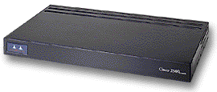
7 Application
ROUTERS
A layer 3 device that is used to interconnect 2 or more logical networks.
Can filter broadcast traffic, preventing broadcast traffic from one network from reaching another network.
6 Presentation
5 Session
4 Transport
180.200.0.0
202.5.3.0
3 Network
2 Data Link
1 Physical

