Slide 1
Multiplexing

Slide 2
Multiplexing refer to the combination of information streams from multiple sources for transmission over a shared medium
  Multiplexor is a mechanism that implements the concept
Demultiplexing refer to the separation of a combination back into separate information streams
  Demultiplexor refer to a mechanism that implements the concept
Example
  each sender communicates with a single receiver
  all pairs share a single transmission medium
  multiplexor combines information from the senders for transmission in such a way that the demultiplexor can separate the information for receivers

Slide 3
Under the simplest conditions, a medium can carry only one signal at any moment in time.
For multiple signals to share one medium, the medium must somehow be divided, giving each signal a portion of the total bandwidth.
The current techniques that can accomplish this include
  frequency division multiplexing (FDM)
  time division multiplexing (TDM)
    Synchronous and statistical
  wavelength division multiplexing (WDM)
  code division multiplexing (CDM)

Slide 4
TDM and FDM are widely used
WDM is a form of FDM used for optical fiber
CDM is a mathematical approach used in cell phone mechanisms
FDM – messages occupy narrow bandwidth – all the time.
TDM – messages occupy wide bandwidth – for short intervals of time

Slide 5
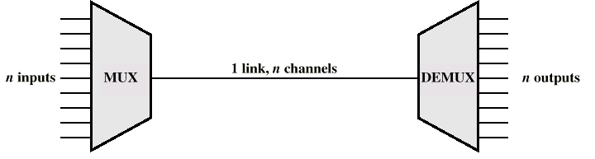
MULTIPLEXING

Slide 6
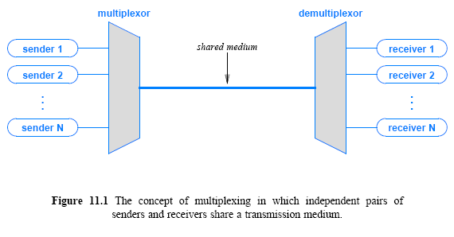

Slide 7
Advantages of Multiplexing
Multiplexing costs less.
Multiplexing was first used to reduce the number of transmission media needed between cities and towns.
This resulted in significantly reduced costs for trunk circuits.
Fiber optic cable allows the multiplexer to combine as many as 6 million signals in one direction on one fiber strand.

Slide 8
Frequency Division Multiplexing
Assignment of non-overlapping frequency ranges to each “user” or signal on a medium. Thus, all signals are transmitted at the same time, each using different frequencies.
A multiplexor accepts inputs and assigns frequencies to each device.
The multiplexor is attached to a high-speed communications line.
A corresponding multiplexor, or demultiplexor, is on the end of the high-speed line and separates the multiplexed signals.

Slide 9
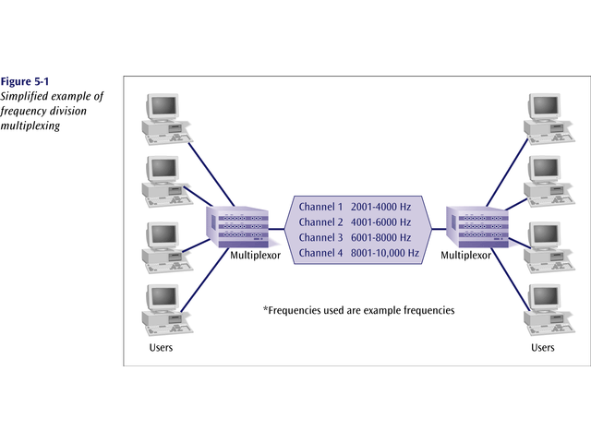

Slide 10
Frequency Division Multiplexing
Analog signaling is used to transmit the signals.
Broadcast radio and television, cable television, and the AMPS cellular phone systems use frequency division multiplexing.
AMPS ((Advanced Mobile Phone System )
This technique is the oldest multiplexing technique.
Since it involves analog signaling, it is more susceptible to noise.

Slide 11
Each signal fed to a FDM system interfaces to the multiplexer through a device called a channel unit.
The channel unit makes changes to the input signal so it can be multiplexed with other signals for transmission.

Slide 12
LIMITATIONS
  If the frequencies of two channels are too close, interference can occur
  Furthermore, demultiplexing hardware that receives a combined signal must be able to divide the signal into separate carriers
  Federal Communications Commission (FCC) in USA regulates stations to insure adequate spacing occurs between the carriers
  Designers should choose a set of carrier frequencies with a gap between them known as a guard band

Slide 13
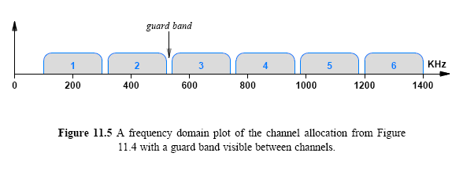

Slide 14
Characteristics of FDM
  Long-lived: FDM, the idea of dividing the electromagnetic spectrum into channels, arose in early experiments in radio
  Widely used: FDM is used in broadcast radio and television, cable television, and the AMPS cellular telephone
  Analog: FDM multiplexing and demultiplexing hardware accepts and delivers analog signals
    Even if a carrier has been modulated to contain digital information, FDM hardware treats the carrier as an analog wave
  Versatile: Because it filters on ranges of frequency without examining other aspects of signals, FDM is versatile

Slide 15
Advantages
FDM has the ability to choose how frequencies can be used
There are two primary ways that systems use a range of frequencies
  Increase the data rate
  Increase immunity to interference
To increase the overall data rate
  a sender divides the frequency range of the channel into K carriers
  and sends 1/K of the data over each carrier

Slide 16
A sender can perform FDM within an allocated channel
  Sometimes, the term subchannel allocation refers to the subdivision
To increase immunity to interference
  a sender uses a technique known as spread spectrum
Various forms are suggested, but basic idea is
  divide the range of the channel into K carriers
  transmit the same data over multiple channels
  allow a receiver to use a copy of the data that arrives with fewest errors
The scheme works well in cases where noise is likely to interfere with some frequencies at a given time

Slide 17
Flexibility in FDM arises from the ability of hardware to shift frequencies
If a set of incoming signals all use the frequency range between 0 and 4 KHz
  multiplexing hardware can leave the first stage as is
  map the second onto the range 4 KHz to 8 KHz
  map the third onto the range 8 KHz to 12 KHz, and so on
Hierarchy in FDM multiplexors is that each maps its inputs to a larger, continuous band of frequencies

Slide 18
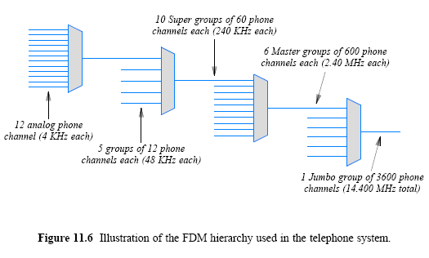
HIERARCHICAL FDM

Slide 19
Disadvantages
The analog characteristic has the disadvantage of making FDM susceptible to noise and distortion

Slide 20
Time Division Multiplexing
Sharing of the signal is accomplished by dividing available transmission time on a medium among users.
Digital signaling is used exclusively.
Time division multiplexing comes in two basic forms:
  1. Synchronous time division multiplexing, and
  2. Statistical, or asynchronous time division multiplexing.

Slide 21
Time Division Multiplexing (TDM)
  Transmission line is divided into time segments
  Guard time separate signals
  Used on Dataphone Digital Service
    Leased digital lines
    Maximum speed of 56 Kbps
  Used on T-1 lines (1.55 Mbps)
  Used on fiber optic networks

Slide 22
Synchronous Time Division Multiplexing
The original time division multiplexing.
The multiplexor accepts input from attached devices in a round-robin fashion and transmit the data in a never ending pattern.
  Most TDMs work this way, but some others do not
T-1 and ISDN telephone lines are common examples of synchronous time division multiplexing.

Slide 23
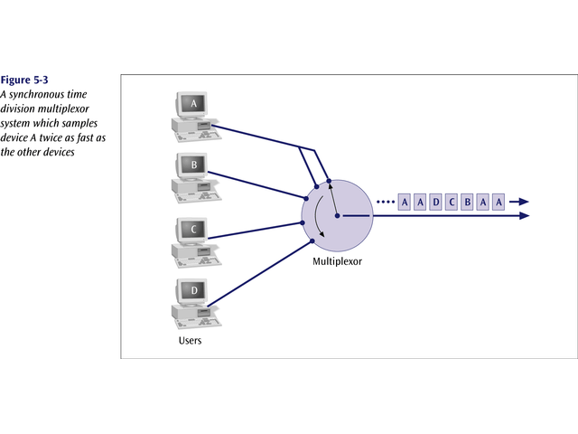

Slide 24
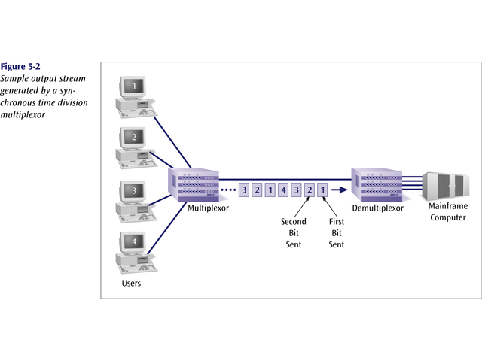

Slide 25
Synchronous Time Division Multiplexing
If one device generates data at a faster rate than other devices, then the multiplexor must either sample the incoming data stream from that device more often than it samples the other devices, or buffer the faster incoming stream.
If a device has nothing to transmit, the multiplexor must still insert a piece of data from that device into the multiplexed stream.

Slide 26
  When TDM is applied to synchronous networks, no gap occurs between items; the result is known as Synchronous TDM

Slide 27
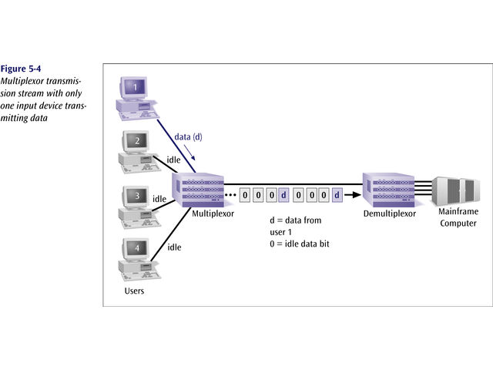

Slide 28
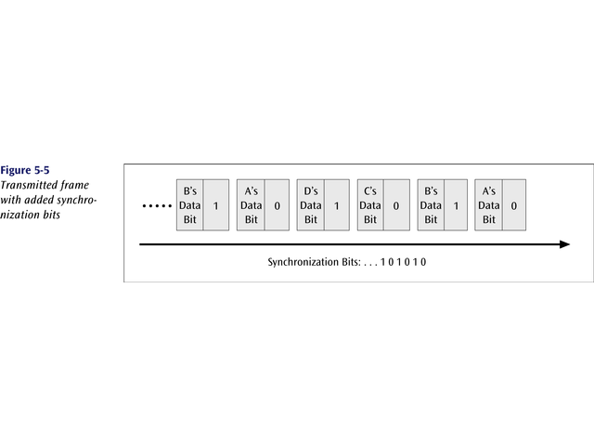
Synchronous time division multiplexing
So that the receiver may stay synchronized with the incoming data stream, the transmitting multiplexor can insert alternating 1s and 0s into the data stream.

Slide 29
Synchronous Time Division Multiplexing
Three types popular today:
  T-1 multiplexing (the classic)
  ISDN multiplexing
  SONET (Synchronous Optical NETwork)

Slide 30
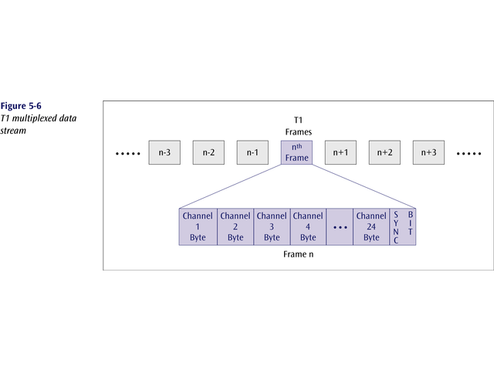
The T1 (1.54 Mbps) multiplexor stream is a continuous series of frames of both digitized data and voice channels.
24 separate 64Kbps channels

Slide 31
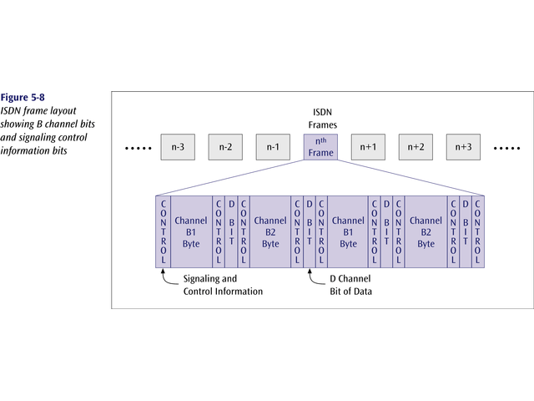
The ISDN multiplexor stream is also a continuous stream of frames. Each frame contains various control and sync info.

Slide 32
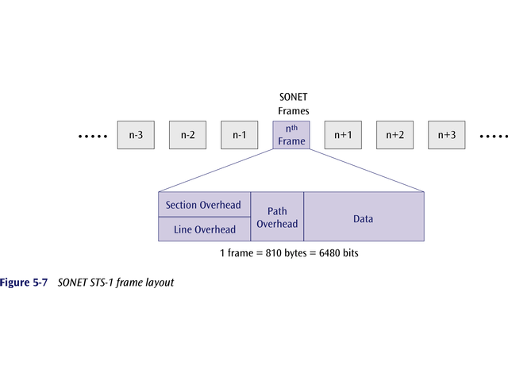
SONET – massive data rates

Slide 33
Synchronous TDM
Very popular
Line will require as much bandwidth as all the bandwidths of the sources

Slide 34
The Problem with Synchronous TDM: Unfilled Slots
Synchronous TDM works well if each source produces data at a uniform, fixed rate equal to 1/N of the capacity of the shared medium
Many sources generate data in bursts, with idle time between bursts
In practice, a slot cannot be empty because the underlying system must continue to transmit data
  the slot is assigned a value (such as zero)
  and an extra bit is set to indicate that the value is invalid

Slide 35
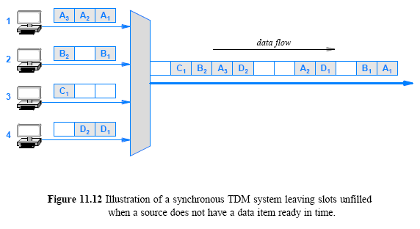
The Problem with Synchronous TDM: Unfilled Slots

Slide 36
Statistical TDM
How can a multiplexing system make better use of a shared medium?
One technique to increase the overall data rate is known as statistical TDM or statistical multiplexing
  some literature uses the term asynchronous TDM
The technique is straightforward:
  select items for transmission in a round-robin fashion
  but instead of leaving a slot unfilled, skip any source that does not have data ready
By eliminating unused slots
  statistical TDM takes less time to send the same amount of data
Figure 11.13 illustrates how a statistical TDM system sends the data from Figure 11.12 in only 8 slots instead of 12

Slide 37
  Provides advanced functions over TDM
    Data compression
    Accumulation and reporting of network statistics
    Some error detection and correction

Slide 38
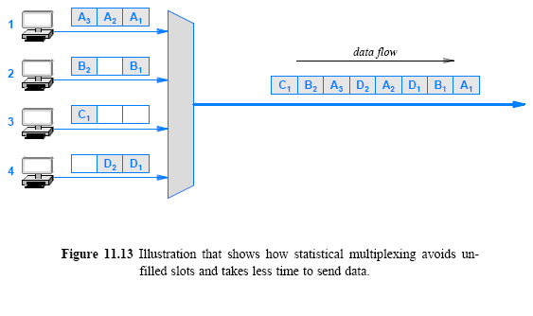
11.13 Statistical TDM

Slide 39
Statistical Time Division Multiplexing
A statistical multiplexor transmits only the data from active workstations (or why work when you don’t have to).
If a workstation is not active, no space is wasted on the multiplexed stream.
A statistical multiplexor accepts the incoming data streams and creates a frame containing only the data to be transmitted.

Slide 40
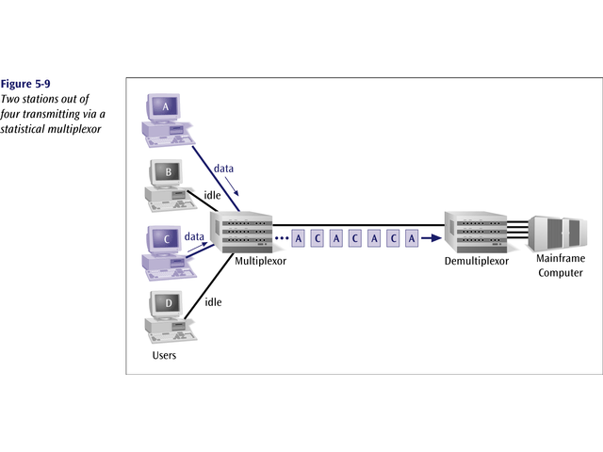

Slide 41
Statistical multiplexing incurs extra overhead
Each slot must contain the identification of the receiver to which the data is being sent

Slide 42
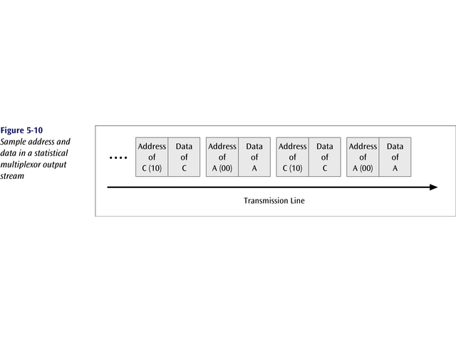
To identify each piece of data, an address is included.

Slide 43
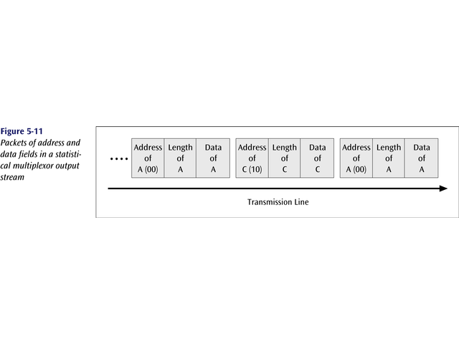
If the data is of variable size, a length is also included.

Slide 44
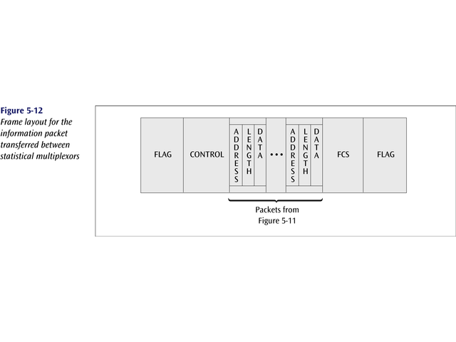
More precisely, the transmitted frame contains a collection of data groups.

Slide 45
Statistical Time Division Multiplexing
A statistical multiplexor does not require a line over as high a speed line as synchronous time division multiplexing since STDM does not assume all sources will transmit all of the time!
Good for low bandwidth lines (used for LANs)
Much more efficient use of bandwidth!

Slide 46
Wavelength Division Multiplexing (WDM)
Give each message a different wavelength (frequency)
Easy to do with fiber optics and optical sources

Slide 47
WDM refers to the application of FDM to optical fiber
  some sources use the term Dense WDM (DWDM) to emphasize that many wavelengths of light can be employed
The inputs and outputs of such multiplexing are wavelengths of light
  denoted by the Greek letter λ, and informally called colors
The velocity of propagation is equal to the product of the wavelength and the frequency
  v_{p} = λ * f

Slide 48
Used for analog and digital transmission over fiber optic cables
Optical equivalent of FDM
Allows up to 400 Gbps on a single cable
Problems connecting to copper cables
    Conversion between electrical and optical signals
    Optical amplifiers – amplifies optical signal

Slide 49
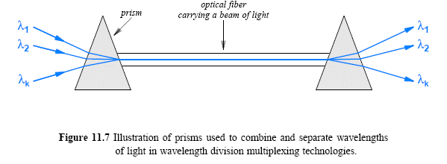
Prisms form the basis of optical multiplexing and demultiplexing
  a multiplexor accepts beams of light of various wavelengths and uses a prism to combine them into a single beam
  a demultiplexor uses a prism to separate the wavelengths.

Slide 50
When white light passes through a prism
  colors of the spectrum are spread out
If a set of colored light beams are each directed into a prism at the correct angle
  the prism will combine the beams to form a single beam of white light

Slide 51
Dense Wavelength Division Multiplexing (DWDM)
Dense wavelength division multiplexing is often called just wavelength division multiplexing
Dense wavelength division multiplexing multiplexes multiple data streams onto a single fiber optic line.
Different wavelength lasers (called lambdas) transmit the multiple signals.
Each signal carried on the fiber can be transmitted at a different rate from the other signals.
Dense wavelength division multiplexing combines many (30, 40, 50, 60, more?) onto one fiber.

Slide 52
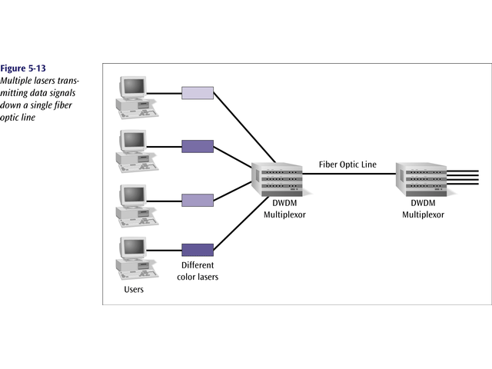
Data Communications and Computer Networks
Chapter 5

Slide 53
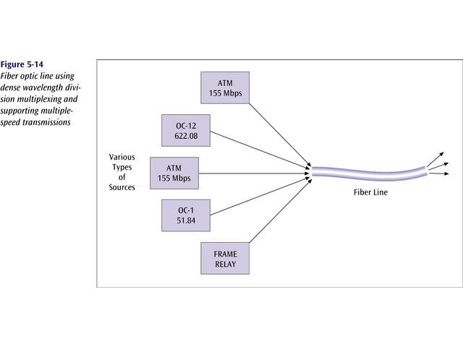
Data Communications and Computer Networks
Chapter 5

Slide 55
Data Communications and Computer Networks
Chapter 5
Code Division Multiplexing (CDM)
  Old but now new method
Also known as code division multiple access (CDMA)
An advanced technique that allows multiple devices to transmit on the same frequencies at the same time using different codes
Used for mobile communications

Slide 56
Code Division Multiplexing (CDM)
CDM used in parts of the cellular telephone system and for some satellite communication
CDM does not rely on physical properties
  such as frequency or time
CDM relies on an interesting mathematical idea
  values from orthogonal vector spaces can be combined and separated without interference
Each sender is assigned a unique binary code C_{i}
  that is known as a chip sequence
  chip sequences are selected to be orthogonal vectors
  (i.e., the dot product of any two chip sequences is zero)

Slide 57
Code Division Multiplexing
At any point in time, each sender has a value to transmit, V_{i}
  The senders each multiply C_{i} x V_{i} and transmit the results
The senders transmit at the same time
  and the values are added together
To extract value V_{i}, a receiver multiplies the sum by C_{i}
Consider an example
  to keep the example easy to understand, use a chip sequence that is only two bits long and data values that are four bits long
  think of the chip sequence as a vector
Figure 11.15 lists the values

Slide 58
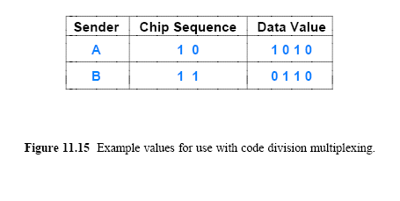
11.15 Code Division Multiplexing

Slide 59
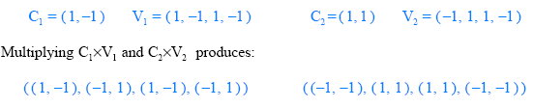
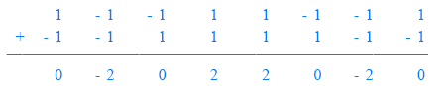
Code Division Multiplexing
The first step consists of converting the binary values into vectors that use -1 to represent 0:
If we think of the resulting values as a sequence of signal strengths to be transmitted at the same time
  the resulting signal will be the sum of the two signals

Slide 60
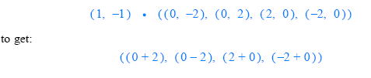
Code Division Multiplexing
A receiver treats the sequence as a vector
  computes the product of the vector and the chip sequence
  treats the result as a sequence, and converts the result to binary by interpreting positive values as binary 1 and negative values as 0
Thus, receiver number 1 computes:
Interpreting the result as a sequence produces: (2 -2 2 -2)
  which becomes the binary value: (1 0 1 0)
  note that 1010 is the correct value of V₁
  receiver 2 will extract V₂ from the same transmission

Slide 61
Code Division Multiple Access (CDMA)
  Each cellular conversation is assigned a code
  Signals are identified by the code
  Uses direct sequence spread spectrum
  Makes higher speed transmission possible

Slide 62
Data Communications and Computer Networks
Chapter 5
Code Division Multiplexing
An advanced technique that allows multiple devices to transmit on the same frequencies at the same time.
Each mobile device is assigned a unique 64-bit code (chip spreading code)
To send a binary 1, mobile device transmits the unique code
To send a binary 0, mobile device transmits the inverse of code

Slide 63
Data Communications and Computer Networks
Chapter 5
Code Division Multiplexing
Receiver gets summed signal, multiplies it by receiver code, adds up the resulting values
Interprets as a binary 1 if sum is near +64
Interprets as a binary 0 if sum is near –64

Slide 64
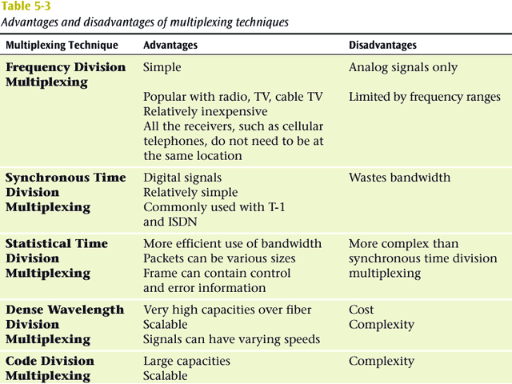

Slide 65
Data Communications and Computer Networks
Chapter 5
Business Multiplexing In Action
XYZ Corporation has two buildings separated by a distance of 300 meters.
A 3-inch diameter tunnel extends underground between the two buildings.
Building A has a mainframe computer and Building B has 66 terminals.
List some efficient techniques to link the two buildings.

Slide 66
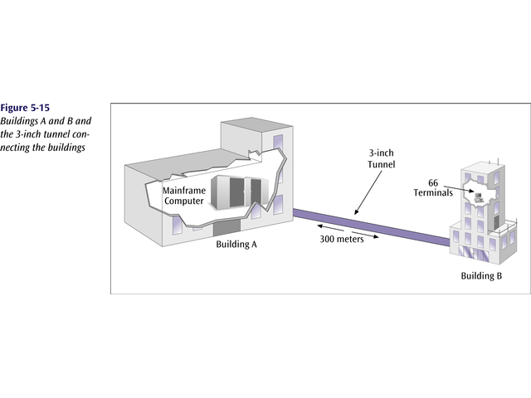
Data Communications and Computer Networks
Chapter 5

Slide 67
Data Communications and Computer Networks
Chapter 5
Possible Solutions
Connect each terminal to the mainframe computer using separate point-to-point lines.
Connect all the terminals to the mainframe computer using one multipoint line.
Connect all the terminal outputs and use microwave transmissions to send the data to the mainframe.
Collect all the terminal outputs using multiplexing and send the data to the mainframe computer using a conducted line.

