Slide 1
Introduction to C#

Slide 2
Object Oriented Programming

Slide 3
C# is an object oriented programming language
In the OOP model, programs are no longer procedural. They do not follow a sequential logic. You, as the programmer, do not take control and determine the sequence of execution. Instead, the user can press keys and click various buttons and boxes in a window. Each user action can cause an event to occur, which triggers a method (a set of programming statements) that you have written. For example, the user clicks on a button labeled Calculate. The clicking causes the button’s Click event to occur, and the program automatically jumps to a method you have written to do the calculation.

Slide 4
The Object Model
In C# you will work with objects, which have properties, methods, and events. Each object is based on a class.
Objects : Think of an object as a thing, or a noun. Examples of objects are forms and controls. Forms are the windows and dialog boxes you place on the screen; controls are the components you place inside a form, such as text boxes, buttons, and list boxes.
Properties: Properties tell something about or control the behavior of an object such as its name, color, size, or location. You can think of properties as adjectives that describe objects. When you refer to a property, you first name the object, add a period, and then name the property. For example, refer to the Text property of a form called SalesForm as SalesForm.Text (pronounced “sales form dot text”).

Slide 5
Methods : Actions associated with objects are called methods . Methods are the verbs of object-oriented programming. Some typical methods are Close , Show , and Clear . Each of the predefined objects has a set of methods that you can use. You will learn to write additional methods to perform actions in your programs. You refer to methods as Object.Method (“object dot method”). For example, a Show method can apply to different objects: BillingForm.Show shows the form object called BillingForm; exitButton.Show shows the button object called exitButton.
Events : You can write methods that execute when a particular event occurs. An event occurs when the user takes an action such as clicking a button, pressing a key, scrolling, or closing a window. Events also can be triggered by actions of other objects, such as repainting a form or a timer reaching a preset point.

Slide 6
Classes
A class is a template or blueprint used to create a new object. Classes contain the definition of all available properties, methods, and events. Each time that you create a new object, it must be based on a class. For example, you may decide to place three buttons on your form. Each button is based on the Button class and is considered one object, called an instance of the class. Each button (or instance) has its own set of properties, methods, and events. One button may be labeled “OK”, one “Cancel”, and one “Exit”. When the user clicks the OK button, that button’s Click event occurs; if the user clicks on the Exit button, that button’s Click event occurs. And, of course, you have written different program instructions for each of the button’s Click events.

Slide 7
An Analogy
If the concepts of classes, objects, properties, methods, and events are still a little unclear, maybe an analogy will help. Consider an Automobile class. When we say automobile, we are not referring to a particular auto, but we know that an automobile has a make and model, a color, an engine, and a number of doors. These elements are the properties of the Automobile class. Each individual auto is an object, or an instance of the Automobile class. Each Automobile object has its own settings for the available properties. For example, each Automobile object has a Color property, such as myAuto.Color = Blue and yourAuto.Color = Red.
The methods, or actions, of the Automobile class might be Start , SpeedUp , SlowDown , and Stop . To refer to the methods of a specific object of the class, use myAuto.Start and yourAuto.Stop .
The events of an Automobile class could be Arrive or Crash. In a C# program, you write event-handling methods that specify the actions you want to take when a particular event occurs for an object. For example, you might write a method to handle the yourAuto.Crash event.

Slide 9
Writing C# Programs

Slide 10
The Three- Step Process
Design the user interface - draw a sketch of the screens that the user will see when running the project. Indicate the names that you plan to give the form and each of the objects on the form.
Plan the properties – For each object, write down the properties that you plan to set or change during the design of the form
Plan the C# code – plan the classes and methods that will execute when you project runs. You will determine which events require action to be taken and then make a step-by-step plan for those actions.

Slide 11
C# Application files
A C# application, called a solution, can consist of one or more projects. Each project can contain one or more form files.

Slide 13
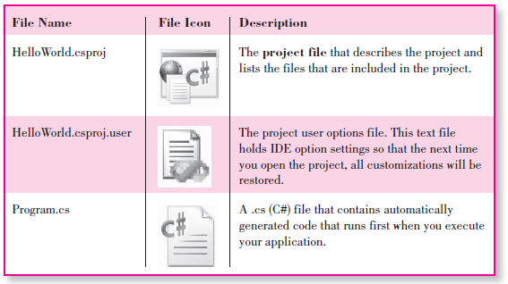

Slide 14
After you run your project, you will find several more files created by the system. The only file that you open directly is the .sln, or solution file.

Slide 15
The New Project Dialog
You will create your first C# projects by selecting File / New Project , which opens the New Project dialog. In the New Project dialog, you may need to expand the node for Other Languages , depending on your installation.
Under Visual C# , select Windows , and in the Templates pane, select Windows Forms Application . You also give the project a name in this dialog. Deselect the check box for Create directory for solution , which creates an extra level of folders for our single-project solutions.

Slide 16
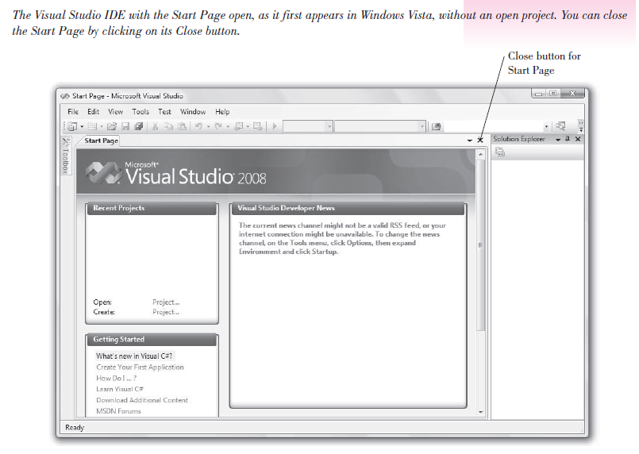

Slide 17
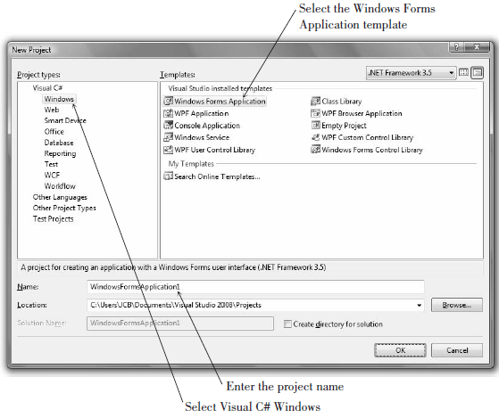

Slide 18
The IDE Main Window
Each window can be moved, resized, opened, closed, and customized. Some windows have tabs that allow you to display different contents.
The Designer and Editor windows are generally displayed in tabs in the center of the screen (the Document
window), and the various tool windows are docked along the edges and bottom of the IDE, but the locations and the docking behavior are all customizable.
The IDE main window holds the Visual Studio menu bar and the toolbars. You can display or hide the various windows from the View menu.

Slide 19
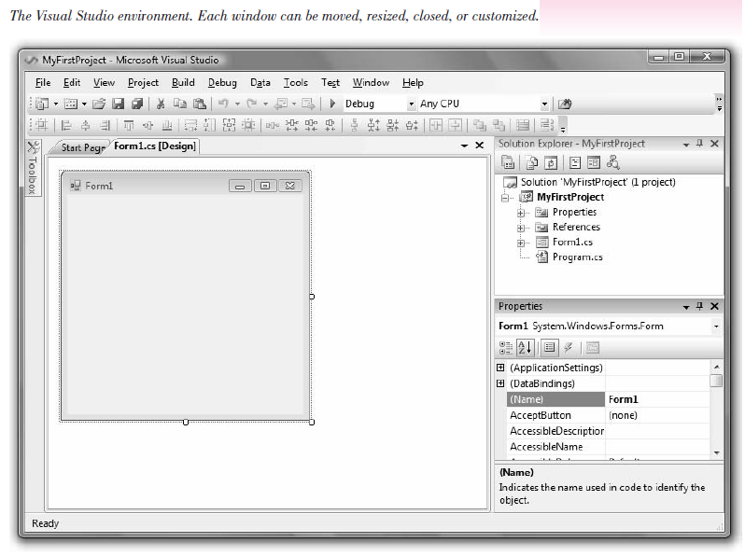

Slide 20
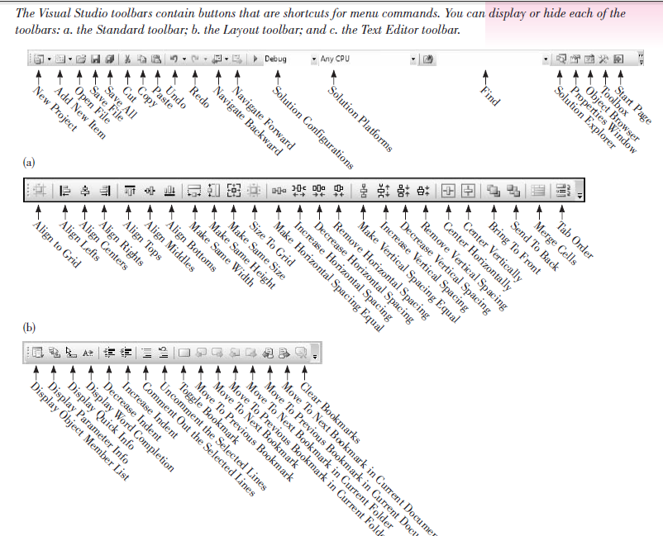
The Toolbars

Slide 21
The Document Window
The largest window in the center of the screen is the Document window .
Notice the tabs across the top of the window, which allow you to switch between open documents. The items that display in the Document window include the Form Designer, the Code Editor, the Project Designer, the Database Designer, and the Object Browser.
You can switch from one tab to another, or close any of the documents using its Close button.

Slide 22
The Form Designer
The Form Designer is where you design a form that makes up your user interface.
You can drag the form’s sizing handles or selection border to change the size of the form.
When you begin a new C# Windows application, a new form is added to the project with the default name Form1. In the step-by-step exercise later in the chapter, you will learn to change the form’s name.

Slide 23
The Solution Explorer Window
The Solution Explorer window holds the filenames for the files included in your project and a list of the classes it references.
The Solution Explorer window and the environment’s title bar hold the name of your solution (.sln) file, which is WindowsFormsApplication1 by default unless you give it a new value in the New Project dialog box.

Slide 24
The Properties Window
You use the Properties window to set the properties for the objects in your project. See “Set Properties” later in this chapter for instructions on changing properties.

Slide 25
The Toolbox
The toolbox holds the tools you use to place controls on a form. You may have more or different tools in your toolbox, depending on the edition of C# you are using (Express, Standard, Professional, or Team System).

Slide 26
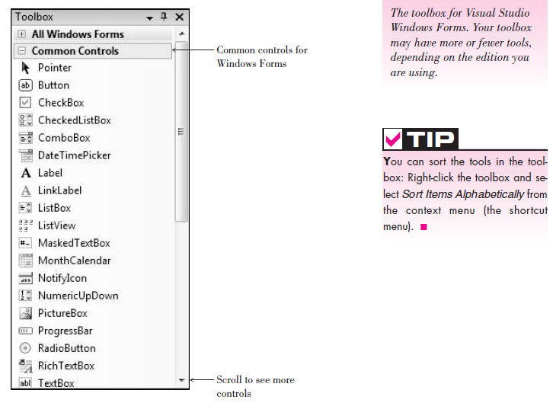

Slide 27
Help
Visual Studio has an extensive Help feature, which includes the Microsoft Developer Network library (MSDN). You can find reference materials for C#, C++, VB, and Visual Studio; several books; technical articles; and the Microsoft Knowledge Base, a database of frequently asked questions and their answers.
Help includes the entire reference manual, as well as many coding examples.
When you make a selection from the Help menu, the requested item appears in a new window that floats on top of the IDE window so you can keep both open at the same time. It’s a good idea to set the Filtered By entry to Visual C# .

Slide 28
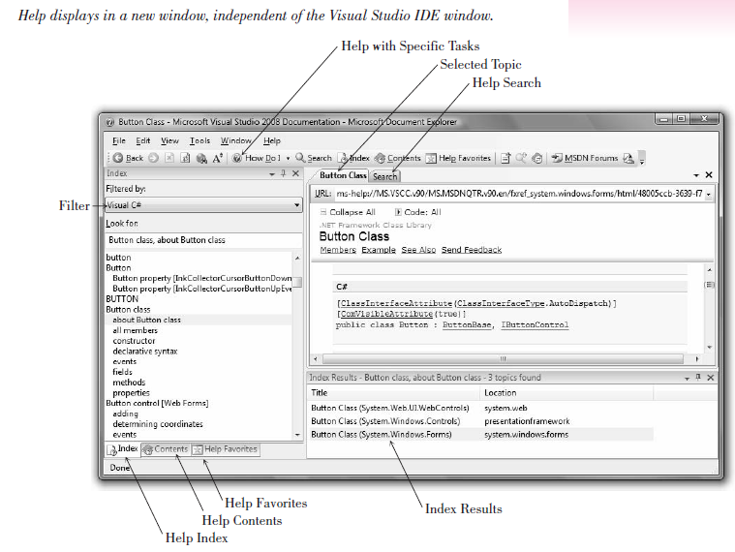

Slide 29
Design Time, Run Time, and Debug Time
Visual Studio has three distinct modes. While you are designing the user interface and writing code, you are in design time . When you are testing and running your project, you are in run time . If you get a run-time error or pause program execution, you are in debug time . The IDE window title bar indicates (Running) or (Debugging) to indicate that a project is no longer in design time.

Slide 30
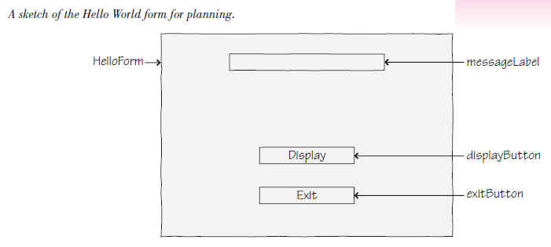
Example (Try)

Slide 31
Write Code
C# Events : While your project is running, the user can do many things, such as move the mouse around; click either button; move, resize, or close your form’s window; or jump to another application. Each action by the user causes an event to occur in your C# project. Some events (like clicking on a button) you care about, and some events (like moving the mouse and resizing the window) you do not care about. If you write code for a particular event, then C# will respond to the event and automatically execute your method. C# ignores events for which no methods are written.

Slide 32
C# Event Handlers
You write code in C# in methods. For now, each method will begin with the words private void and the code will be enclosed in opening and closing braces { }.
C# automatically names your event-handling methods (also called event handlers ). The name consists of the object name, an underscore (_), and the name of the event. For example, the Click event for your button called display- Button will be displayButton_Click. For the sample project you are writing, you will have a displayButton_Click method and an exitButton_Click method.

Slide 33
C# Code Statements
This first project requires two C# statements: the comment and the assignment statement . You also will execute a method of an object.
The Comment Statement : Comment statements, sometimes called remarks , are used for project documentation only. They are not considered “executable” and have no effect when the program runs. The purpose of comments is to make the project more readable and understandable by the people who read it. Good programming practices dictate that programmers include comments to clarify their projects.

Slide 34
Every method should begin with a comment that describes its purpose. Every project should have comments that explain the purpose of the program and provide identifying information such as the name of the programmer and the date the program was written and/or modified. In addition, it is a good idea to place comments within the logic of a project, especially if the purpose of any statements might be unclear.
When you try to read someone else’s code or your own after a period of time, you will appreciate the generous use of comments. C# comments begin with slashes. Most of the time, your comments will be on a separate line. You also can add slashes and a comment to the right end of a line of code.

Slide 35
The Comment Statement—Examples
Examples
// This project was written by Jonathon Edwards.
// Exit the project.
messageLabel.Text = "Hello World"; // Assign the message to the Text property.
Multiline Comments: You also can create multiline comments by placing /* at the beginning and */ at the end. The enclosing symbols can be on lines by themselves or on existing lines. As you type additional lines between the beginning and ending symbols, the editor adds an asterisk at the start of each line, indicating that it is a comment line. However, you do not need the * at the beginning of each line. When you want to turn multiple lines of code into comments, just add the opening /* and ending */ .

Slide 36
Ending a Statement
Most C# statements must be terminated by a semicolon (;). Comments and a few other statements (which you will learn about later) do not end with a semicolon.
A C# statement may extend over multiple lines; the semicolon indicates that the statement is complete.

Slide 37
The Assignment Statement
The assignment statement assigns a value to a property or variable. Assignment statements operate from right to left; that is, the value that appears on the right side of the equal sign is assigned to the property named on the left of the equal sign. It is often helpful to read the equal sign as “is replaced by.” For example, the following assignment statement would read “messageLabel.Text is replaced by Hello World.”
messageLabel.Text = "Hello World";

Slide 38
The Assignment Statement—General Form
Object.Property = value ;
The value named on the right side of the equal sign is assigned to (or placed into) the property named on the left.

Slide 39
The Assignment Statement—Examples
Examples
titleLabel.Text = "A Snazzy Program";
addressLabel.Text = "1234 South North Street";
messageLabel.AutoSize = true;
numberInteger = 12;
Notice that when the value to assign is some actual text (called a literal ), it is enclosed in quotation marks. This convention allows you to type any combination of alpha and numeric characters. If the value is numeric, do not enclose it in quotation marks. And do not place quotation marks around the terms true and false , which C# recognizes as special key terms.

Slide 40
Ending a Program by Executing a Method
To execute a method of an object, you write: Object.Method ();
Notice that methods always have parentheses. Although this might seem like a bother, it’s helpful to distinguish between properties and methods: Methods always have parentheses; properties don’t.
Examples
helloButton.Hide();
messageLabel.Show();

Slide 41
To execute a method of the current form, you use the this keyword for the object. And the method that closes the form and terminates the project execution is Close .
this.Close();
In most cases, you will include this.Close() in the event-handling method for an Exit button or an Exit menu choice.
Note : Remember, the keyword this refers to the current object. You can omit this since a method without an object reference defaults to the current object.

Slide 42
The Label’s AutoSize Property
Earlier you changed the AutoSize property of messageLabel to False, a step that allows you to set the size of the label yourself.
When AutoSize is set to True (the default), the label resizes automatically to accommodate the Text property, which can be an advantage when the text or font size may change. However, if you plan to delete the Text property, as you did for messageLabel, the label resizes to such a tiny size that it is difficult to see.

Slide 43
Any time that you want to set the size of a label yourself, change the AutoSize property to False. This setting also allows you to create taller labels that allow a long Text property to wrap to multiple lines. If you set the Text property to a very long value when AutoSize is set to True, the label will resize only to the edge of the form and cut off any excess text, but if AutoSize is set to False and the label has been resized to a taller height, the long Text property will wrap.

Slide 44
Automatically Generated Code
In the preceding code listing, you see many statements that you wrote, plus some more that appeared “automatically.” Although a programmer could begin a C# program by using a simple text editor and write all of the necessary statements to make the program run, using the development tools of the Visual Studio IDE is much quicker and more efficient. The IDE adds a group of statements by default and sets up the files for the project to accommodate the majority of applications. Later, when your programs include database tables, you will have to write additional using statements.

Slide 45
The Using Statements
The using statements appear at the top of the file after the comments that you wrote. Using statements provide references to standard groups of classes from the language library. For example, the statement using System.Windows.Forms; allows your program to refer to all of the Windows controls that appear in the toolbox. Without the using statement, each time that you wanted to refer to a Label control, for example, you would have to specify the complete reference: System.Windows.Forms.Label.messageLabel . Instead, in the program with the using statement, you can just refer to messageLabel .

Slide 46
The Namespace Statement
A namespace provides a way to refer to programming components by location or organization. In the Label example in the preceding section, “Label” is the class and “System.Windows.Forms” is the namespace, or library grouping where “Label” is found. You can think of a namespace as similar to a telephone area code: In any one area code, a single phone number can appear only once, but that same phone number can appear in any number of other area codes.

Slide 47
Using the .NET Framework, every program component is required to have a namespace. The VS IDE automatically adds a namespace statement to your program. The default namespace is the name of your solution, but you can use a different name if you wish. Many companies use the namespace to organize applications such as the company name and functional organization, LookSharpFitnessCenter.Payroll , for example.
In Visual Studio, one solution can contain multiple projects. All of the solutions in this text contain only one project, so you can think of a solution and a project as being equal.

Slide 48
The Class Statement
In object-oriented programming, code is organized into classes. A new class can be based on (inherit from) another class, which gives the new class all of the properties and methods of the original class (the base class).
When you create a new form, you declare a new class (HelloForm in the earlier example). The new class inherits from the Form base class, which makes your new form behave like a standard form, with a title bar, maximize and minimize buttons, and resizable borders, among other behaviors.

Slide 49
A class may be split into multiple files. VS uses this feature, to place most of the code automatically generated by the Form Designer in a separate file that is part of the form’s class.
The automatically generated statement
public partial class HelloForm : Form
means that this is a new class called HelloForm that inherits from the Form class. The new class is a partial class, so another file can exist that also contains statements that are part of the HelloForm class. You will learn more about classes and files in later chapters.

Slide 50
Finding and Fixing Errors
You already may have seen some errors as you entered the first sample project.
Programming errors come in three varieties: syntax errors, run-time errors, and
logic errors.

Slide 51
Syntax Errors
When you break C#’s rules for punctuation, format, or spelling, you generate a syntax error . Fortunately, the smart editor finds most syntax errors and even corrects many of them for you. The syntax errors that the editor cannot identify are found and reported by the compiler as it attempts to convert the code into intermediate machine language. A compiler-reported syntax error may be referred to as a compile error .

Slide 52
The editor identifies syntax errors as you move off the offending line. A red squiggly line appears under the part of the line that the editor cannot interpret. You can view the error message by pausing the mouse pointer over the error, which pops up a box that describes the error .
You also can display an Error List window, which appears at the bottom of the Editor window and shows all error messages along with the line number of the statement that caused the error. You can display line numbers on the source code with Tools / Options / Text Editor / C# / General / Display / Line Numbers .

Slide 53
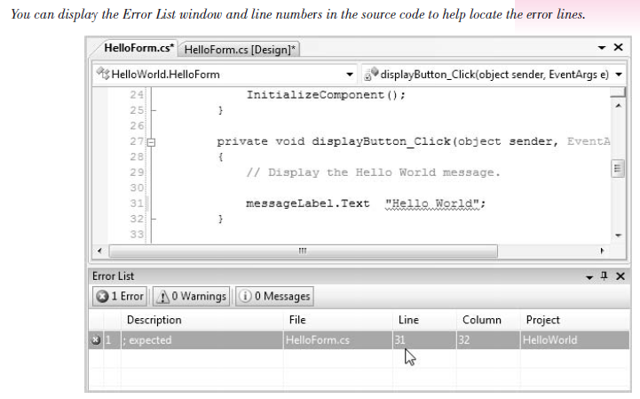

Slide 54
The quickest way to jump to an error line is to point to a message in the Error List window and double-click. The line in error will display in the Editor window with the error highlighted .
If a syntax error is found by the compiler, you will see the dialog box shown. Click No and return to the editor, correct your errors, and run the program again.

Slide 55
Run-Time Errors
If your project halts during execution, it is called a run-time error or an exception . C# displays a dialog box and highlights the statement causing the problem.
Statements that cannot execute correctly cause run-time errors. The statements are correctly formed C# statements that pass the syntax checking; however, the statements fail to execute due to some serious issue. You can cause run-time errors by attempting to do impossible arithmetic operations, such as calculate with nonnumeric data, divide by zero, or find the square root of a negative number.

Slide 56
Logic Errors
When your program contains logic errors , the program runs but produces incorrect results. Perhaps the results of a calculation are incorrect or the wrong text appears or the text is okay but appears in the wrong location.
Beginning programmers often overlook their logic errors. If the project runs, it must be right—right? All too often, that statement is not correct. You may need to use a calculator to check the output. Check all aspects of the project output: computations, text, and spacing.

Slide 57
Project Debugging
If you talk to any computer programmer, you will learn that programs don’t have errors—programs get “bugs” in them. Finding and fixing these bugs is called debugging .
For syntax errors and run-time errors, your job is easier. C# displays the Editor window with the offending line highlighted. However, you must identify and locate logic errors yourself.
C# also includes a very popular feature: edit-and-continue. If you are able to identify the run-time error and fix it, you can continue project execution from that location by clicking on the Start Debugging button, pressing F5, or choosing Debug / Continue . You also can correct the error and restart from the beginning.
The Visual Studio IDE has some very helpful tools to aid in debugging your projects.

Slide 58
A Clean Compile
When you start executing your program, the first step is called compiling , which means that the C# statements are converted to Microsoft Intermediate Language (MSIL). Your goal is to have no errors during the compile process: a clean compile .

Slide 59
Modifying an Event Handler
When you double-click a Button control to begin writing an event-handling method for the Click event, several things happen. As an example, say that youhave a button on your form called button1 . If you double-click button1, the Editor window opens with a template for the new method:
private void button1_Click(object sender, EventArgs e)
{
}

Slide 60
The insertion point appears between the opening and closing braces, where you can begin typing your new method. But behind the scenes, VS also adds a line to the (hidden) FormName .Designer.cs file that assigns this new method to the Click event of the button.

Slide 61
As long as you keep the name of the button unchanged and don’t delete the method, all is well. But if you want to rename the button, or perhaps delete the method (maybe you accidentally double-clicked a label or the form and have a method that you really don’t want or need), then you will need to take additional steps.

Slide 62
Deleting an Event Handler
Assume that you have double-clicked the form called Form1 and now have an extra event handler that you do not want. If you simply delete the event handler, your program generates an error message due to the extra code that appears in the Form’s designer.cs file. When you double-click on the form, the extra Form Load event handler looks like this:
private void Form1_Load(object sender, EventArgs e)
{
}

Slide 63
If you delete these lines of code and try to run the program, you receive an error message that “‘WindowsApplication1.Form1’ does not contain a definition for ‘Form1_Load’.” If you double-click on the error message, it takes you to a line in the Form1.Designer.cs file. You can delete the line of code that it takes you to, which, in this example, is
this.Load += new System.EventHandler(this.Form1_Load);

Slide 64
The preferable way to remove the statement that assigns the event handler is to use the Properties window in the designer. First, make sure to select the form or control that has the unwanted event handler assigned; then click on the Events button in the Properties window . You will see the event-handling method’s name for the name of the event. You can select and delete the name of the method, which removes the assignment statement from the Designer.cs file, and you will not generate an error message when you delete the code lines.

Slide 65
Renaming a Control
You can receive an error if you rename a control after you write the code for its event. For this example, assume that you add a button that is originally called button1 . You write the code for the button1_Click event handler and then decide to change the button’s name to exitButton. (This scenario occurs quite often, especially with beginning programmers.)

Slide 66
P r o g r a m m i n g E x e r c i s e s
For your first C# exercise, you must first complete the Hello World project. Then add buttons and event-handling methods to display the “Hello World” message in two more languages. You may substitute any other languages for those shown. Feel free to modify the user interface to suit yourself (or your instructor).
Make sure to use meaningful names for your new buttons, following the naming conventions. Include comments at the top of every method and at the top of the file.
“Hello World” in French: Bonjour tout le monde
“Hello World” in Italian: Ciao Mondo

Slide 67
Exercise 2
Create a project that displays the hours for each department on campus. Include buttons for Student Learning, Financial Aid, Counseling, and the Bookstore. Each button should display the hours for that department in a label. The interface should have one label for the hours, one label for the programmer name, buttons for each department, and an Exit button.
Make sure to use meaningful names for your new buttons, following the naming conventions. Include comments at the top of every method and at the top of the file.

Slide 68
Exercise 3
Write a project that displays four sayings, such as “The early bird gets the worm” or “A penny saved is a penny earned.” (You will want to keep the sayings short, as each must be entered on one line. However, when the saying displays on your form, you can set the label’s properties to allow long lines to wrap within the label.)
Make a button for each saying with a descriptive Text property for each, as well as a button to exit the project.

Slide 69
Include a label that holds your name at the bottom of the form. Also, make sure to change the form’s title bar to something meaningful. If your sayings are too long to display on one line, set the label’s Auto- Size property to False and resize the height of the label to hold multiple lines. You may change the Font properties of the label to the font and size of your choice.
Make sure the buttons are large enough to hold their entire Text properties.
Follow good naming conventions for object names; include comments at the top of every method and at the top of the file.

Slide 70
Exercise 4
Write a project to display company contact information. Include buttons and labels for the contact person, department, and phone. When the user clicks on one of the buttons, display the contact information in the corresponding label. Include a button to exit.
Include a label that holds your name at the bottom of the form and change the title bar of the form to something meaningful.
You may change the Font properties of the labels to the font and size of your choice.
Follow good naming conventions for object names; include comments at the top of every method and at the top of the file.

