Slide 1
Normalization of Database Tables
Contn

Slide 2
SURROGATE KEY CONSIDERATIONS
Although this design meets the vital entity and referential integrity requirements, the designer must still address some concerns.
For example, a composite primary key might become too cumbersome to use as the number of attributes grows. (It becomes difficult to create a suitable foreign key when the related table uses a composite primary key. In addition, a composite primary key makes it more difficult to write search routines.)
Or a primary key attribute might simply have too much descriptive content to be usable—which is why the JOB_CODE attribute was added to the JOB table to serve as that table’s primary key.
When, for whatever reason, the primary key is considered to be unsuitable, designers use surrogate keys

Slide 3
At the implementation level, a surrogate key is a system-defined attribute generally created and managed via the DBMS.
Usually, a system-defined surrogate key is numeric, and its value is automatically incremented for each new row.
For example, Microsoft Access uses an AutoNumber data type, Microsoft SQL Server uses an identity column, and Oracle uses a sequence object.
Recall from Section 6.4 that the JOB_CODE attribute was designated to be the JOB table’s primary key.
However, remember that the JOB_CODE does not prevent duplicate entries from being made, as shown in the JOB table in Table 6.4.

Slide 4
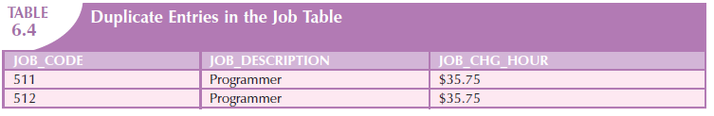
Clearly, the data entries in Table 6.4 are inappropriate because they duplicate existing records—yet there has been no violation of either entity integrity or referential integrity.
This “multiple duplicate records” problem was created when the JOB_CODE attribute was added as the PK. (When the JOB_DESCRIPTION was initially designated to be the PK, the DBMS would ensure unique values for all job description entries when it was asked to enforce entity integrity. But that option created the problems that caused the use of the JOB_CODE attribute in the first place!)
In any case, if JOB_CODE is to be the surrogate PK, you still must ensure the existence of unique values in the JOB_DESCRIPTION through the use of a unique index.

Slide 5
Note that all of the remaining tables (PROJECT, ASSIGNMENT, and EMPLOYEE) are subject to the same limitations.
For example, if you use the EMP_NUM attribute in the EMPLOYEE table as the PK, you can make multiple entries for the same employee.
To avoid that problem, you might create a unique index for EMP_LNAME, EMP_FNAME, and EMP_INITIAL. But how would you then deal with two employees named Joe B. Smith? In that case, you might use another (preferably externally defined) attribute to serve as the basis for a unique index.

Slide 6
It is worth repeating that database design often involves trade-offs and the exercise of professional judgment.
In a real-world environment, you must strike a balance between design integrity and flexibility.
For example, you might design the ASSIGNMENT table to use a unique index on PROJ_NUM, EMP_NUM, and ASSIGN_DATE if you want to limit an employee to only one ASSIGN_HOURS entry per date.
That limitation would ensure that employees couldn’t enter the same hours multiple times for any given date.
Unfortunately, that limitation is likely to be undesirable from a managerial point of view.
After all, if an employee works several different times on a project during any given day, it must be possible to make multiple entries for that same employee and the same project during that day.
In that case, the best solution might be to add a new externally defined attribute—such as a stub, voucher, or ticket number—to ensure uniqueness.
In any case, frequent data audits would be appropriate.

Slide 7
HIGHER-LEVEL NORMAL FORMS
Tables in 3NF will perform suitably in business transactional databases.
However, there are occasions when higher normal forms are useful.
In this section, you will learn about a special case of 3NF, known as Boyce-Codd normal form (BCNF), and about fourth normal form (4NF).

Slide 8
The Boyce-Codd Normal Form (BCNF)
A table is in Boyce-Codd normal form (BCNF) when every determinant in the table is a candidate key. (A candidate key has the same characteristics as a primary key, but for some reason, it was not chosen to be the primary key.)
Clearly, when a table contains only one candidate key, the 3NF and the BCNF are equivalent.
Putting that proposition another way, BCNF can be violated only when the table contains more than one candidate key.

Slide 9
Note
A table is in Boyce-Codd normal form (BCNF) when every determinant in the table is a candidate key.

Slide 10
Most designers consider the BCNF to be a special case of the 3NF.
In fact, if the techniques shown here are used, most tables conform to the BCNF requirements once the 3NF is reached.
So how can a table be in 3NF and not be in BCNF? To answer that question, you must keep in mind that a transitive dependency exists when one nonprime attribute is dependent on another nonprime attribute.
In other words, a table is in 3NF when it is in 2NF and there are no transitive dependencies.
But what about a case in which a nonkey attribute is the determinant of a key attribute? That condition does not violate 3NF, yet it fails to meet the BCNF requirements because BCNF requires that every determinant in the table be a candidate key.
The situation just described (a 3NF table that fails to meet BCNF requirements) is shown in Figure 6.7.

Slide 11
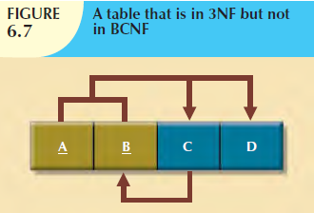

Slide 12
Note these functional dependencies in Figure 6.7:
A + B → C, D
A + C → B, D
C → B
Notice that this structure has two candidate keys: (A + B) and (A + C).
The table structure shown in Figure 6.7 has no partial dependencies, nor does it contain transitive dependencies.
(The condition C → B indicates that a nonkey attribute determines part of the primary key—and that dependency is not transitive or partial because the dependent is a prime attribute!)
Thus, the table structure in Figure 6.7 meets the 3NF requirements.
Yet the condition C → B causes the table to fail to meet the BCNF requirements.

Slide 13
To convert the table structure in Figure 6.7 into table structures that are in 3NF and in BCNF, first change the primary key to A + C.
That is an appropriate action because the dependency C → B means that C is, in effect, a superset of B.
At this point, the table is in 1NF because it contains a partial dependency, C → B.
Next, follow the standard decomposition procedures to produce the results shown in Figure 6.8.
To see how this procedure can be applied to an actual problem, examine the sample data in Table 6.5.

Slide 14
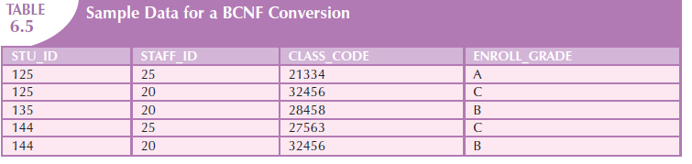

Slide 15
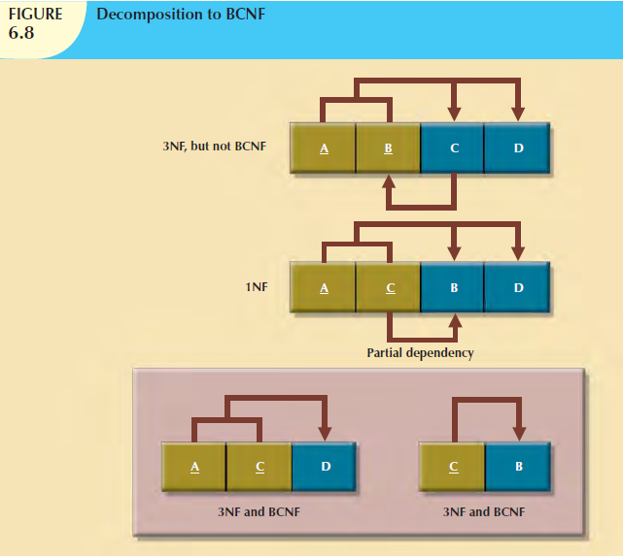

Slide 16
Table 6.5 reflects the following conditions:
Each CLASS_CODE identifies a class uniquely. This condition illustrates the case in which a course might generate many classes. For example, a course labeled INFS 420 might be taught in two classes (sections), each identified by a unique code to facilitate registration. Thus, the CLASS_CODE 32456 might identify INFS 420, class section 1, while the CLASS_CODE 32457 might identify INFS 420, class section 2. Or the CLASS_CODE 28458 might identify QM 362, class section 5.
A student can take many classes. Note, for example, that student 125 has taken both 21334 and 32456, earning the grades A and C, respectively.
A staff member can teach many classes, but each class is taught by only one staff member. Note that staff member 20 teaches the classes identified as 32456 and 28458.

Slide 17
The structure shown in Table 6.5 is reflected in Panel A of Figure 6.9:
STU_ID + STAFF_ID → CLASS_CODE, ENROLL_GRADE
CLASS_CODE → STAFF_ID
Panel A of Figure 6.9 shows a structure that is clearly in 3NF, but the table represented by this structure has a major problem, because it is trying to describe two things: staff assignments to classes and student enrollment information.
Such a dual-purpose table structure will cause anomalies.
For example, if a different staff member is assigned to teach class 32456, two rows will require updates, thus producing an update anomaly. And if student 135 drops class 28458, information about who taught that class is lost, thus producing a deletion anomaly.

Slide 18
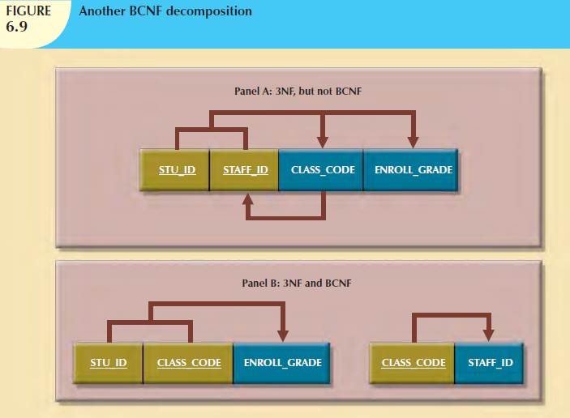

Slide 19
information about who taught that class is lost, thus producing a deletion anomaly.
The solution to the problem is to decompose the table structure, following the procedure outlined earlier.
Note that the decomposition of Panel B shown in Figure 6.9 yields two table structures that conform to both 3NF and BCNF requirements.
Remember that a table is in BCNF when every determinant in that table is a candidate key.
Therefore, when a table contains only one candidate key, 3NF and BCNF are equivalent.

Slide 20
Fourth Normal Form (4NF)
You might encounter poorly designed databases, or you might be asked to convert spreadsheets into a database format in which multiple multivalued attributes exist.
For example, consider the possibility that an employee can have multiple assignments and can also be involved in multiple service organizations.
Suppose employee 10123 does volunteer work for the Red Cross and United Way.
In addition, the same employee might be assigned to work on three projects: 1, 3, and 4. Figure 6.10 illustrates how that set of facts can be recorded in very different ways.

Slide 21
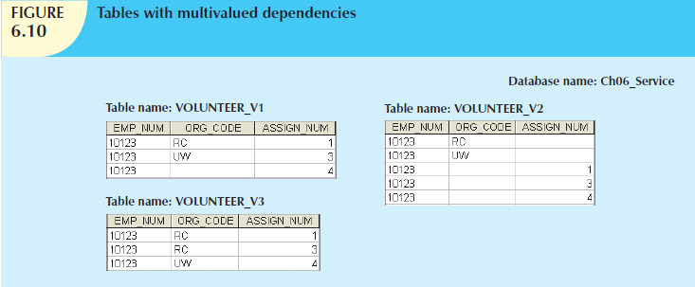

Slide 22
There is a problem with the tables in Figure 6.10.
The attributes ORG_CODE and ASSIGN_NUM each may have many different values.
In normalization terminology, this situation is referred to as a multivalued dependency.
A multivalued dependency occurs when one key determines multiple values of two other attributes and those attributes are independent of each other. (One employee can have many service entries and many assignment entries. Therefore,
one EMP_NUM can determine multiple values of ORG_CODE and multiple values of ASSIGN_NUM; however, ORG_CODE and ASSIGN_NUM are independent of each other.)
The presence of a multivalued dependency means that if versions 1 and 2 are implemented, the tables are likely to contain quite a few null values; in fact, the tables do not even have a viable candidate key. (The EMP_NUM values are not unique, so they cannot be PKs. No combination of the attributes in table versions 1 and 2 can be used to create a PK because some of them contain nulls.)
Such a condition is not desirable, especially when there are thousands of employees, many of whom may have multiple job assignments and many service activities.
Version 3 at least has a PK, but it is composed of all of the attributes in the table.
In fact, version 3 meets 3NF requirements, yet it contains many redundancies that are clearly undesirable.

Slide 23
The solution is to eliminate the problems caused by the multivalued dependency.
You do this by creating new tables for the components of the multivalued dependency.
In this example, the multivalued dependency is resolved by creating the ASSIGNMENT and SERVICE_V1 tables depicted in Figure 6.11.
Note that in Figure 6.11, neither the ASSIGNMENT nor the SERVICE_V1 table contains a multivalued dependency.
Those tables are said to be in 4NF.
If you follow the proper design procedures illustrated in this book, you shouldn’t encounter the previously described problem.
Specifically, the discussion of 4NF is largely academic if you make sure that your tables conform to the following two rules:
  All attributes must be dependent on the primary key, but they must be independent of each other.
  No row may contain two or more multivalued facts about an entity.

Slide 24
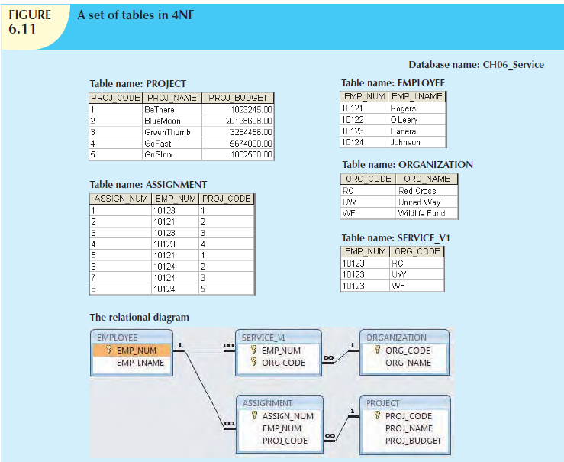

Slide 25
Note
A table is in fourth normal form (4NF) when it is in 3NF and has no multivalued dependencies.

Slide 26
NORMALIZATION AND DATABASE DESIGN
The tables shown in Figure 6.6 illustrate how normalization procedures can be used to produce good tables from poor ones.
You will likely have ample opportunity to put this skill into practice when you begin to work with real-world databases.
Normalization should be part of the design process.
Therefore, make sure that proposed entities meet the required normal form before the table structures are created.
Keep in mind that if you follow the design procedures discussed, the likelihood of data anomalies will be small.
But even the best database designers are known to make occasional mistakes that come to light during normalization checks.
However, many of the real-world databases you encounter will have been improperly designed or burdened with anomalies if they were improperly modified over the course of time.
And that means you might be asked to redesign and modify existing databases that are, in effect, anomaly traps.
Therefore, you should be aware of good design principles and procedures as well as normalization procedures.

Slide 27
First
An ERD is created through an iterative process.
You begin by identifying relevant entities, their attributes, and their relationships.
Then you use the results to identify additional entities and attributes.
The ERD provides the big picture, or macro view, of an organization’s data requirements and operations.

Slide 28
Second
Normalization focuses on the characteristics of specific entities; that is, normalization represents a micro view of the entities within the ERD.
And as you learned in the previous sections, the normalization process might yield additional entities and attributes to be incorporated into the ERD.
Therefore, it is difficult to separate the normalization process from the ER modeling process; the two techniques are used in an iterative and incremental process.

Slide 29
To illustrate the proper role of normalization in the design process, let’s reexamine the operations of the contracting company whose tables were normalized in the preceding sections.
Those operations can be summarized by using the following business rules:
  The company manages many projects.
  Each project requires the services of many employees.
  An employee may be assigned to several different projects.
  Some employees are not assigned to a project and perform duties not specifically related to a project. Some employees are part of a labor pool, to be shared by all project teams. For example, the company’s executive secretary would not be assigned to any one particular project.
  Each employee has a single primary job classification. That job classification determines the hourly billing rate.
  Many employees can have the same job classification. For example, the company employs more than one electrical engineer.

Slide 30
Given that simple description of the company’s operations, two entities and their attributes are initially defined:
PROJECT (PROJ_NUM, PROJ_NAME)
EMPLOYEE (EMP_NUM, EMP_LNAME, EMP_FNAME, EMP_INITIAL, JOB_DESCRIPTION, JOB_CHG_HOUR)

Slide 31
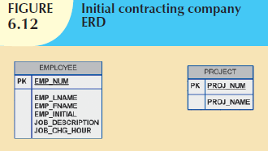

Slide 32
After creating the initial ERD shown in Figure 6.12, the normal forms are defined:
  PROJECT is in 3NF and needs no modification at this point.
  EMPLOYEE requires additional scrutiny. The JOB_DESCRIPTION attribute defines job classifications such as Systems Analyst, Database Designer, and Programmer. In turn, those classifications determine the billing rate, JOB_CHG_HOUR. Therefore, EMPLOYEE contains a transitive dependency.
The removal of EMPLOYEE’s transitive dependency yields three entities:
PROJECT (PROJ_NUM, PROJ_NAME)
EMPLOYEE (EMP_NUM, EMP_LNAME, EMP_FNAME, EMP_INITIAL, JOB_CODE)
JOB (JOB_CODE, JOB_DESCRIPTION, JOB_CHG_HOUR)

Slide 33
Because the normalization process yields an additional entity (JOB), the initial ERD is modified as shown in Figure 6.13.
To represent the M:N relationship between EMPLOYEE and PROJECT, you might think that two 1:M relationships could be used—an employee can be assigned to many projects, and each project can have many employees assigned to it. (See Figure 6.14.)
Unfortunately, that representation yields a design that cannot be correctly implemented.
Because the M:N relationship between EMPLOYEE and PROJECT cannot be implemented, the ERD in Figure 6.14 must be modified to include the ASSIGNMENT entity to track the assignment of employees to projects, thus yielding the ERD shown in Figure 6.15.

Slide 34
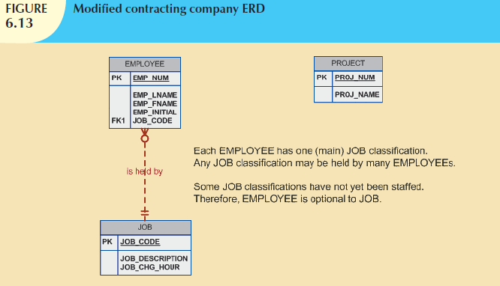

Slide 35
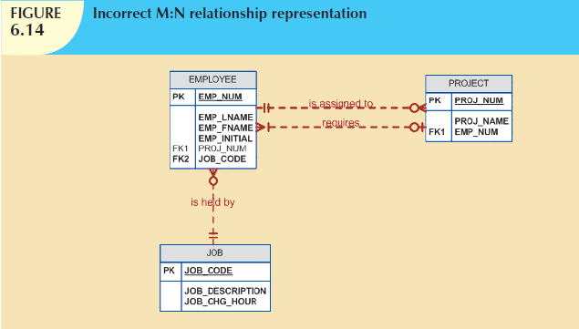

Slide 36
The ASSIGNMENT entity in Figure 6.15 uses the primary keys from the entities PROJECT and EMPLOYEE to serve as its foreign keys.
However, note that in this implementation, the ASSIGNMENT entity’s surrogate primary key is ASSIGN_NUM, to avoid the use of a composite primary key.
Therefore, the “enters” relationship between EMPLOYEE and ASSIGNMENT and the “requires” relationship between PROJECT and ASSIGNMENT are shown as weak or nonidentifying.
Note that in Figure 6.15, the ASSIGN_HOURS attribute is assigned to the composite entity named ASSIGNMENT.
Because you will likely need detailed information about each project’s manager, the creation of a “manages” relationship is useful.
The “manages” relationship is implemented through the foreign key in PROJECT.
Finally, some additional attributes may be created to improve the system’s ability to generate additional information.

Slide 37
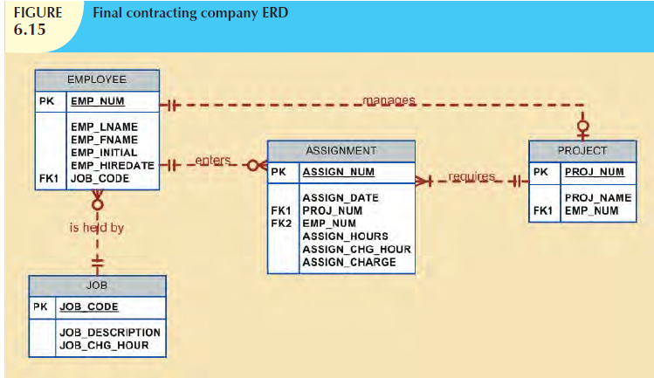

Slide 38
For example, you may want to include the date on which the employee was hired (EMP_HIREDATE) to keep track of worker longevity.
Based on this last modification, the model should include four entities and their attributes:
PROJECT (PROJ_NUM, PROJ_NAME, EMP_NUM)
EMPLOYEE (EMP_NUM, EMP_LNAME, EMP_FNAME, EMP_INITIAL, EMP_HIREDATE, JOB_CODE)
JOB (JOB_CODE, JOB_DESCRIPTION, JOB_CHG_HOUR)
ASSIGNMENT (ASSIGN_NUM, ASSIGN_DATE, PROJ_NUM, EMP_NUM, ASSIGN_HOURS, ASSIGN_CHG_HOUR, ASSIGN_CHARGE)

Slide 39
The design process is now on the right track.
The ERD represents the operations accurately, and the entities now
reflect their conformance to 3NF.
The combination of normalization and ER modeling yields a useful ERD, whose entities may now be translated into appropriate table structures.
In Figure 6.15, note that PROJECT is optional to EMPLOYEE in the “manages” relationship.
This optionality exists because not all employees manage projects.
The final database contents are shown in Figure 6.16.

Slide 40
DENORMALIZATION
It’s important to remember that the optimal relational database implementation requires that all tables be at least in third normal form (3NF).
A good relational DBMS excels at managing normalized relations; that is, relations void of any unnecessary redundancies that might cause data anomalies.
Although the creation of normalized relations is an important database design goal, it is only one of many such goals.
Good database design also considers processing (or reporting) requirements and processing speed.
The problem with normalization is that as tables are decomposed to conform to normalization requirements, the number of database tables expands.
Therefore, in order to generate information, data must be put together from various tables.
Joining a large number of tables takes additional input/output (I/O) operations and processing logic, thereby reducing system speed.
Most relational database systems are able to handle joins very efficiently.
However, rare and occasional circumstances may allow some degree of denormalization so processing speed can be increased.

Slide 41
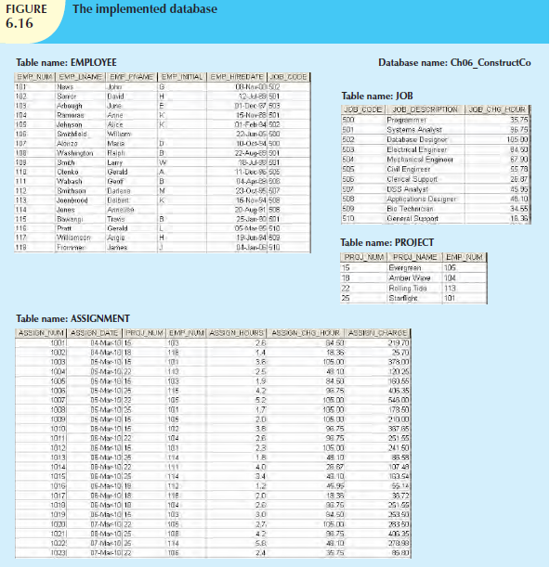

Slide 42
Keep in mind that the advantage of higher processing speed must be carefully weighed against the disadvantage of data anomalies.
On the other hand, some anomalies are of only theoretical interest.
For example, should people in a real-world database environment worry that a ZIP_CODE determines CITY in a CUSTOMER table whose primary key is the customer number? Is it really practical to produce a separate table for ZIP (ZIP_CODE, CITY)
to eliminate a transitive dependency from the CUSTOMER table? (Perhaps your answer to that question changes if you are in the business of producing mailing lists.)
As explained earlier, the problem with denormalized relations and redundant data is that the data integrity could be compromised due to the possibility of data anomalies (insert, update, and deletion anomalies).
The advice is simple: use common sense during the normalization process.
Furthermore, the database design process could, in some cases, introduce some small degree of redundant data in the model (as seen in the previous example).
This, in effect, creates “denormalized” relations. Table 6.6 shows some common examples of data redundancy that are generally found in database implementations.

Slide 43
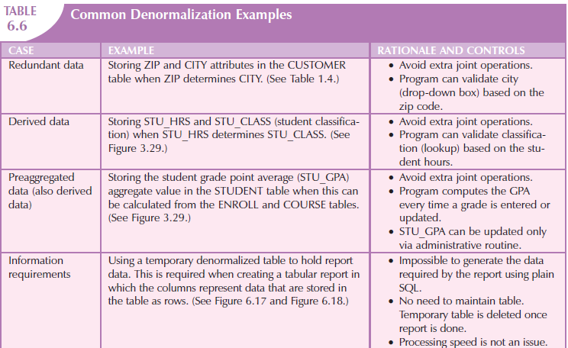

Slide 44
A more comprehensive example of the need for denormalization due to reporting requirements is the case of a faculty evaluation report in which each row list the scores obtained during the last four semesters taught. (See Figure 6.17.)

Slide 45
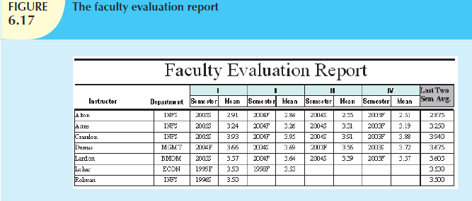

Slide 46
Although this report seems simple enough, the problem arises from the fact that the data are stored in a normalized table in which each row represents a different score for a given faculty member in a given semester. (See Figure 6.18.)
The difficulty of transposing multirow data to multicolumnar data is compounded by the fact that the last four semesters taught are not necessarily the same for all faculty members (some might have taken sabbaticals, some might have had research appointments, some might be new faculty with only two semesters on the job, etc.).

Slide 47
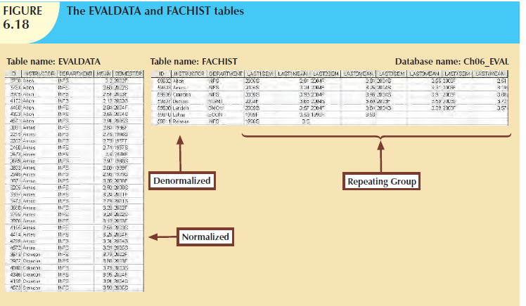

Slide 48
To generate this report, the two tables you see in Figure 6.18 were used.
The EVALDATA table is the master data table containing the evaluation scores for each faculty member for each semester taught; this table is normalized.
The FACHIST table contains the last four data points—that is, evaluation score and semester—for each faculty member.
The FACHIST table is a temporary denormalized table created from the EVALDATA table via a series of queries. (The FACHIST table is the basis for the report shown in Figure 6.17.)

Slide 49
As seen in the faculty evaluation report, the conflicts between design efficiency, information requirements, and performance are often resolved through compromises that may include denormalization. In this case, and assuming there is enough storage space, the designer’s choices could be narrowed down to:
  Store the data in a permanent denormalized table. This is not the recommended solution, because the denormalized table is subject to data anomalies (insert, update, and delete). This solution is viable only if performance is an issue.
  Create a temporary denormalized table from the permanent normalized table(s). Because the denormalized table exists only as long as it takes to generate the report, it disappears after the report is produced. Therefore, there are no data anomaly problems. This solution is practical only if performance is not an issue and there are no other viable processing options.

Slide 50
As shown, normalization purity is often difficult to sustain in the modern database environment.
In Business Intelligence and Data Warehouses, lower normalization forms occur (and are even required) in specialized databases known as data warehouses.
Such specialized databases reflect the ever-growing demand for greater scope and depth in the data on which decision support systems increasingly rely.
You will discover that the data warehouse routinely uses 2NF structures in its complex, multilevel, multisource data environment.
In short, although normalization is very important, especially in the so-called production database environment, 2NF is no longer disregarded as it once was.

Slide 51
Although 2NF tables cannot always be avoided, the problem of working with tables that contain partial and/or transitive dependencies in a production database environment should not be minimized.
Aside from the possibility of troublesome data anomalies being created, unnormalized tables in a production database tend to suffer from these defects:
  Data updates are less efficient because programs that read and update tables must deal with larger tables.
  Indexing is more cumbersome. It is simply not practical to build all of the indexes required for the many attributes that might be located in a single unnormalized table.
  Unnormalized tables yield no simple strategies for creating virtual tables known as views.

Slide 52
Remember that good design cannot be created in the application programs that use a database.
Also keep in mind that unnormalized database tables often lead to various data redundancy disasters in production databases such as the ones examined thus far.
In other words, use denormalization cautiously and make sure that you can explain why the unnormalized tables are a better choice in certain situations than their normalized counterparts.

Slide 53
DATA-MODELING CHECKLIST
You have learned how data modeling translates a specific real-world environment into a data model that represents the real-world data, users, processes, and interactions.
The modeling techniques you have learned thus far give you the tools needed to produce successful database designs.
However, just as any good pilot uses a checklist to ensure that all is in order for a successful flight, the data-modeling checklist shown in Table 6.7 will help ensure that you perform data-modeling tasks successfully based on the concepts and tools you have learned in this text.

Slide 54
