Slide 1
Relational Database Model

Slide 2
A LOGICAL VIEW OF DATA
The relational model enables you to view data logically rather than physically.
The practical significance of taking the logical view is that it serves as a reminder of the simple file concept of data storage.
Although the use of a table, quite unlike that of a file, has the advantages of structural and data independence, a table does resemble a file from a conceptual point of view.
Because you can think of related records as being stored in independent tables, the relational database model is much easier to understand than the hierarchical and network models.
Logical simplicity tends to yield simple and effective database design methodologies.
Because the table plays such a prominent role in the relational model, it deserves a closer look.
Therefore, our discussion begins with an exploration of the details of table structure and contents.

Slide 3
Tables and Their Characteristics
The logical view of the relational database is facilitated by the creation of data relationships based on a logical construct known as a relation.
Because a relation is a mathematical construct, end users find it much easier to think of a relation as a table.
A table is perceived as a two-dimensional structure composed of rows and columns.
A table is also called a relation because the relational model’s creator, E. F. Codd, used the term relation as a synonym for table.
You can think of a table as a persistent representation of a logical relation, that is, a relation whose contents can be permanently saved for future use.
As far as the table’s user is concerned, a table contains a group of related entity occurrences, that is, an entity set.
For example, a STUDENT table contains a collection of entity occurrences, each representing a student. For that reason, the terms entity set and table are often used interchangeably.

Slide 4
Note
The word relation, also known as a dataset in Microsoft Access, is based on the mathematical set theory from which Codd derived his model.
Because the relational model uses attribute values to establish relationships among tables, many database users incorrectly assume that the term relation refers to such relationships.
Many then incorrectly conclude that only the relational model permits the use of relationships.

Slide 5
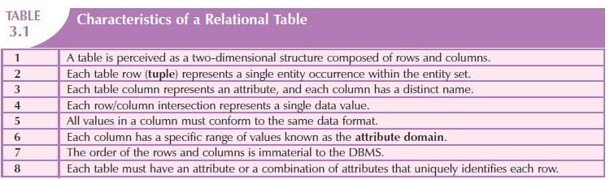
Characteristics of a relational table

Slide 6
Note
Relational database terminology is very precise.
Unfortunately, file system terminology sometimes creeps into the database environment.
Thus, rows are sometimes referred to as records and columns are sometimes labeled as fields.
Occasionally, tables are labeled files.
Technically speaking, this substitution of terms is not always appropriate; the database table is a logical rather than a physical concept, and the terms file, record, and field describe physical concepts.
Nevertheless, as long as you recognize that the table is actually a logical rather than a physical construct, you may (at the conceptual level) think of table rows as records and of table columns as fields.
In fact, many database software vendors still use this familiar file system terminology.

Slide 7
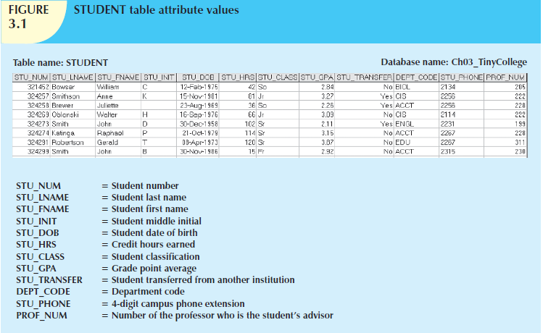
Student Table

Slide 8
Using the STUDENT table, you can draw the following conclusions corresponding to the points
1. The STUDENT table is perceived to be a two-dimensional structure composed of eight rows (tuples) and twelve columns (attributes).
2. Each row in the STUDENT table describes a single entity occurrence within the entity set. (The entity set is represented by the STUDENT table.) For example, row 4 in Figure 3.1 describes a student named Walter H. Oblonski. Given the table contents, the STUDENT entity set includes eight distinct entities (rows), or students.
3. Each column represents an attribute, and each column has a distinct name.

Slide 9
4. All of the values in a column match the attribute’s characteristics. For example, the grade point average (STU_GPA) column contains only STU_GPA entries for each of the table rows. Data must be classified according to their format and function. Although various DBMSs can support different data types, most support at least the following:
  a. Numeric. Numeric data are data on which you can perform meaningful arithmetic procedures. For example, in Figure 3.1, STU_HRS and STU_GPA are numeric attributes.
  b. Character. Character data, also known as text data or string data, can contain any character or symbol not intended for mathematical manipulation. In Figure 3.1, STU_CLASS and STU_PHONE are examples of character attributes.
  c. Date. Date attributes contain calendar dates stored in a special format known as the Julian date format. For example, STU_DOB in Figure 3.1 is a date attribute.
  d. Logical. Logical data can only have true or false (yes or no) values. In Figure 3.1, the STU_TRANSFER attribute uses a logical data format.
5. The column’s range of permissible values is known as its domain. Because the STU_GPA values are limited to the range 0–4, inclusive, the domain is [0,4].

Slide 10
6. The order of rows and columns is immaterial to the user.
7. Each table must have a primary key. In general terms, the primary key (PK) is an attribute (or a combination of attributes) that uniquely identifies any given row. In this case, STU_NUM (the student number) is the primary key. Using the data presented in Figure 3.1, observe that a student’s last name (STU_LNAME) would not be good primary key because it is possible to find several students whose last name is Smith. Even the combination of the last name and first name (STU_FNAME) would not be an appropriate primary key because, as Figure 3.1 shows, it is quite possible to find more than one student named John Smith.

Slide 11
KEYS
In the relational model, keys are important because they are used to ensure that each row in a table is uniquely identifiable.
They are also used to establish relationships among tables and to ensure the integrity of the data.
Therefore, a proper understanding of the concept and use of keys in the relational model is very important.
A key consists of one or more attributes that determine other attributes.
For example, an invoice number identifies all of the invoice attributes, such as the invoice date and the customer name.

Slide 12
One type of key, the primary key, has already been introduced.
Given the structure of the STUDENT table shown, defining and describing the primary key seem simple enough.
However, because the primary key plays such an important role in the relational environment, you will examine the primary key’s properties more carefully.
You also will become acquainted with superkeys, candidate keys, and secondary keys.

Slide 13
The key’s role is based on a concept known as determination.
In the context of a database table, the statement “A determines B” indicates that if you know the value of attribute A, you can look up (determine) the value of attribute B.
For example, knowing the STU_NUM in the STUDENT table means that you are able to look up (determine) that student’s last name, grade point average, phone number, and so on.
The shorthand notation for “A determines B” is A → B. If A determines B, C, and D, you write A → B, C, D.
Therefore, using the attributes of the STUDENT table, you can represent the statement “STU_NUM determines STU_LNAME” by writing:
STU_NUM → STU_LNAME

Slide 14
In fact, the STU_NUM value in the STUDENT table determines all of the student’s attribute values. For example, you can write:
STU_NUM → STU_LNAME, STU_FNAME, STU_INIT
and
STU_NUM → STU_LNAME, STU_FNAME, STU_INIT, STU_DOB, STU_TRANSFER
In contrast, STU_NUM is not determined by STU_LNAME because it is quite possible for several students to have the last name Smith.

Slide 15
The principle of determination is very important because it is used in the definition of a central relational database concept known as functional dependence.
The term functional dependence can be defined most easily this way: the attribute B is functionally dependent on A if A determines B. More precisely:
The attribute B is functionally dependent on the attribute A if each value in column A determines one and only one value in column B.

Slide 16
Using the contents of the STUDENT table in Figure 3.1, it is appropriate to say that STU_PHONE is functionally dependent on STU_NUM. For example, the STU_NUM value 321452 determines the STU_PHONE value 2134.
On the other hand, STU_NUM is not functionally dependent on STU_PHONE because the STU_PHONE value 2267 is associated with two STU_NUM values: 324274 and 324291. (This could happen when roommates share a single land line phone number.) Similarly, the STU_NUM value 324273 determines the STU_LNAME value Smith. But the STU_NUM value is not functionally dependent on STU_LNAME because more than one student may have the last name Smith.

Slide 17
The functional dependence definition can be generalized to cover the case in which the determining attribute values occur more than once in a table. Functional dependence can then be defined this way:
Attribute A determines attribute B (that is, B is functionally dependent on A) if all of the rows in the table that agree in value for attribute A also agree in value for attribute B.

Slide 18
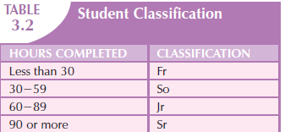
Be careful when defining the dependency’s direction. For example, Gigantic State University determines its student classification based on hours completed

Slide 19
Therefore, you can write:
STU_HRS → STU_CLASS
But the specific number of hours is not dependent on the classification.
It is quite possible to find a junior with 62 completed hours or one with 84 completed hours.
In other words, the classification (STU_CLASS) does not determine one and only one value for completed hours (STU_HRS).

Slide 20
Keep in mind that it might take more than a single attribute to define functional dependence; that is, a key may be composed of more than one attribute. Such a multiattribute key is known as a composite key.
Any attribute that is part of a key is known as a key attribute.
For instance, in the STUDENT table, the student’s last name would not be sufficient to serve as a key.
On the other hand, the combination of last name, first name, initial, and phone is very likely to produce unique matches for the remaining attributes.

Slide 21
For example, you can write:
STU_LNAME, STU_FNAME, STU_INIT, STU_PHONE → STU_HRS, STU_CLASS
or
STU_LNAME, STU_FNAME, STU_INIT, STU_PHONE → STU_HRS, STU_CLASS, STU_GPA
or
STU_LNAME, STU_FNAME, STU_INIT, STU_PHONE → STU_HRS, STU_CLASS, STU_GPA, STU_DOB
Given the possible existence of a composite key, the notion of functional dependence can be further refined by specifying full functional dependence:
If the attribute (B) is functionally dependent on a composite key (A) but not on any subset of that composite key, the attribute (B) is fully functionally dependent on (A).

Slide 22
Within the broad key classification, several specialized keys can be defined.
For example, a superkey is any key that uniquely identifies each row.
In short, the superkey functionally determines all of a row’s attributes.
In the STUDENT table, the superkey could be any of the following:
STU_NUM
STU_NUM, STU_LNAME
STU_NUM, STU_LNAME, STU_INIT
In fact, STU_NUM, with or without additional attributes, can be a superkey even when the additional attributes are redundant.

Slide 23
A candidate key can be described as a superkey without unnecessary attributes, that is, a minimal superkey.
Using this distinction, note that the composite key
STU_NUM, STU_LNAME
is a superkey, but it is not a candidate key because STU_NUM by itself is a candidate key! The combination
STU_LNAME, STU_FNAME, STU_INIT, STU_PHONE
might also be a candidate key, as long as you discount the possibility that two students share the same last name, first name, initial, and phone number.

Slide 24
If the student’s Social Security number had been included as one of the attributes in the STUDENT table —perhaps named STU_SSN—both it and STU_NUM would have been candidate keys because either one would uniquely identify each student.
In that case, the selection of STU_NUM as the primary key would be driven by the designer’s choice or by end-user requirements.
In short, the primary key is the candidate key chosen to be the unique row identifier.
Note, incidentally, that a primary key is a superkey as well as a candidate key.
Within a table, each primary key value must be unique to ensure that each row is uniquely identified by the primary key.
In that case, the table is said to exhibit entity integrity.
To maintain entity integrity, a null (that is, no data entry at all) is not permitted in the primary key.

Slide 25
Note
A null is no value at all. It does not mean a zero or a space.
A null is created when you press the Enter key or the Tab key to move to the next entry without making a prior entry of any kind.
Pressing the Spacebar creates a blank (or a space).

Slide 26
Nulls can never be part of a primary key, and they should be avoided—to the greatest extent possible—in other attributes, too.
There are rare cases in which nulls cannot be reasonably avoided when you are working with nonkey attributes.
For example, one of an EMPLOYEE table’s attributes is likely to be the EMP_INITIAL.
However, some employees do not have a middle initial.
Therefore, some of the EMP_INITIAL values may be null.
There may be situations in which a null exists because of the nature of the relationship between two entities.
In any case, even if nulls cannot always be avoided, they must be used sparingly.
In fact, the existence of nulls in a table is often an indication of poor database design.

Slide 27
Nulls, if used improperly, can create problems because they have many different meanings.
For example, a null can represent:
  An unknown attribute value.
  A known, but missing, attribute value.
  A “not applicable” condition.
Depending on the sophistication of the application development software, nulls can create problems when functions such as COUNT, AVERAGE, and SUM are used.
In addition, nulls can create logical problems when relational tables are linked.

Slide 28
Controlled redundancy makes the relational database work.
Tables within the database share common attributes that enable the tables to be linked together.
For example, note that the PRODUCT and VENDOR tables share a common attribute named VEND_CODE.
And note that the PRODUCT table’s VEND_CODE value 232 occurs more than once, as does the VEND_CODE value 235.
Because the PRODUCT table is related to the VENDOR table through these VEND_CODE values, the multiple occurrence of the values is required to make the 1:M relationship between VENDOR and PRODUCT work.
Each VEND_CODE value in the VENDOR table is unique—the VENDOR is the “1” side in the VENDOR-PRODUCT relationship.
But any given VEND_CODE value from the VENDOR table may occur more than once in the PRODUCT table, thus providing evidence that PRODUCT is the “M” side of the VENDOR-PRODUCT relationship. In database terms, the multiple occurrences of the VEND_CODE values in the PRODUCT table are not redundant because they are required to make the relationship work.

Slide 29
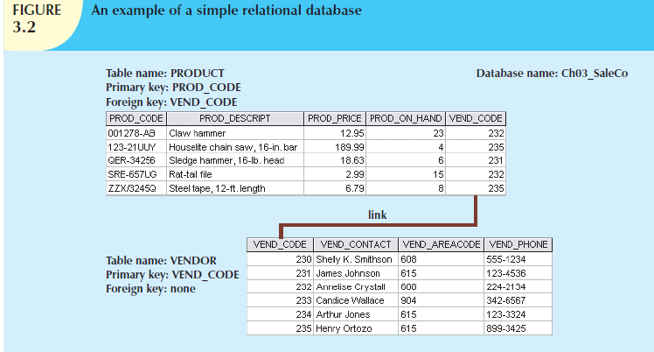

Slide 30
As you examine Figure 3.2, note that the VEND_CODE value in one table can be used to point to the corresponding value in the other table.
For example, the VEND_CODE value 235 in the PRODUCT table points to vendor Henry Ortozo in the VENDOR table.
Consequently, you discover that the product “Houselite chain saw, 16-in. bar” is delivered by Henry Ortozo and that he can be contacted by calling 615-899-3425.
The same connection can be made for the product “Steel tape, 12-ft. length” in the PRODUCT table.
Remember the naming convention—the prefix PROD was used in Figure 3.2 to indicate that the attributes “belong” to the PRODUCT table.
Therefore, the prefix VEND in the PRODUCT table’s VEND_CODE indicates that VEND_CODE points to some other table in the database.
In this case, the VEND prefix is used to point to the VENDOR table in the database.

Slide 31
A relational database can also be represented by a relational schema.
A relational schema is a textual representation of the database tables where each table is listed by its name followed by the list of its attributes in parentheses.
The primary key attribute(s) is (are) underlined.
For example, the relational schema for Figure 3.2 would be shown as:
VENDOR (VEND_CODE, VEND_CONTACT, VEND_AREACODE, VEND_PHONE)
PRODUCT (PROD_CODE, PROD_DESCRIPT, PROD_PRICE, PROD_ON_HAND, VEND_CODE)

Slide 32
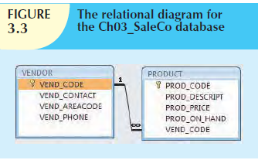

Slide 33
Note that the link in Figure 3.3 is the equivalent of the relationship line in an ERD.
This link is created when two tables share an attribute with common values.
More specifically, the primary key of one table (VENDOR) appears as the foreign key in a related table (PRODUCT).
A foreign key (FK) is an attribute whose values match the primary key values in the related table.
For example, in Figure 3.2, the VEND_CODE is the primary key in the VENDOR table, and it occurs as a foreign key in the PRODUCT table.

Slide 34
Because the VENDOR table is not linked to a third table, the VENDOR table shown in Figure 3.2 does not contain a foreign key.
If the foreign key contains either matching values or nulls, the table that makes use of that foreign key is said to exhibit referential integrity.
In other words, referential integrity means that if the foreign key contains a value, that value refers to an existing valid tuple (row) in another relation.
Note that referential integrity is maintained between the PRODUCT and VENDOR tables shown in Figure 3.2.

Slide 35
Finally, a secondary key is defined as a key that is used strictly for data retrieval purposes.
Suppose customer data are stored in a CUSTOMER table in which the customer number is the primary key.
Do you suppose that most customers will remember their numbers? Data retrieval for a customer can be facilitated when the customer’s last name and phone number are used.
In that case, the primary key is the customer number; the secondary key is the combination of the customer’s last name and phone number.
Keep in mind that a secondary key does not necessarily yield a unique outcome.
For example, a customer’s last name and home telephone number could easily yield several matches where one family lives together and shares a phone line.
A less efficient secondary key would be the combination of the last name and zip code; this could yield dozens of matches, which could then be combed for a specific match.

Slide 36
A secondary key’s effectiveness in narrowing down a search depends on how restrictive that secondary key is.
For instance, although the secondary key CUS_CITY is legitimate from a database point of view, the attribute values “New York” or “Sydney” are not likely to produce a usable return unless you want to examine millions of possible matches.
(Of course, CUS_CITY is a better secondary key than CUS_COUNTRY.)

Slide 37
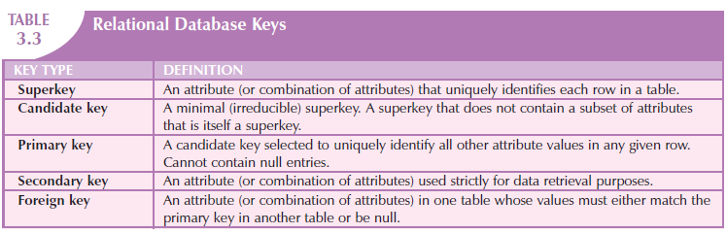

Slide 38
INTEGRITY RULES
Relational database integrity rules are very important to good database design.
Many (but by no means all) RDBMSs enforce integrity rules automatically.
However, it is much safer to make sure that your application design conforms to the entity and referential integrity rules mentioned

Slide 39
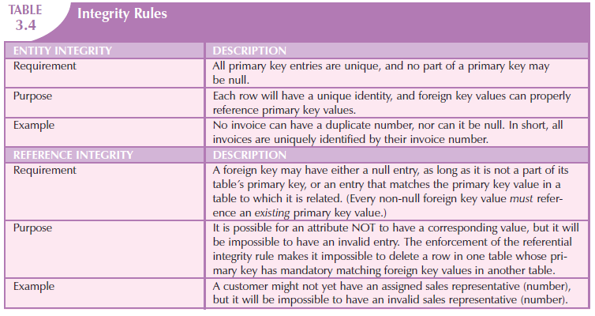

Slide 40
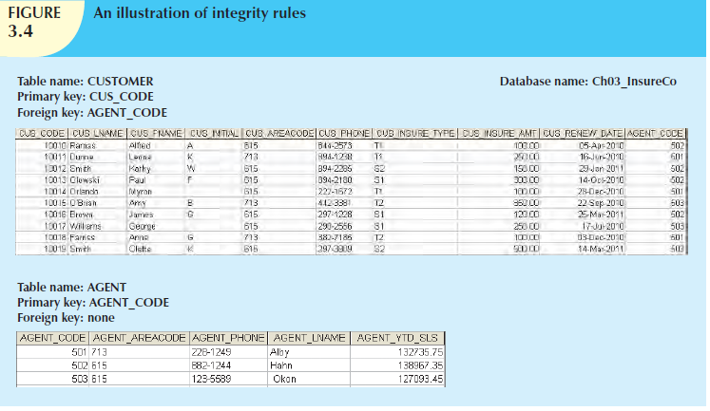

Slide 41
Note the following features of Figure 3.4.
Entity integrity. The CUSTOMER table’s primary key is CUS_CODE. The CUSTOMER primary key column has no null entries, and all entries are unique. Similarly, the AGENT table’s primary key is AGENT_CODE, and this primary key column is also free of null entries.
Referential integrity. The CUSTOMER table contains a foreign key, AGENT_CODE, which links entries in the CUSTOMER table to the AGENT table. The CUS_CODE row that is identified by the (primary key) number 10013 contains a null entry in its AGENT_CODE foreign key because Mr. Paul F. Olowski does not yet have a sales representative assigned to him. The remaining AGENT_CODE entries in the CUSTOMER table all match the AGENT_CODE entries in the AGENT table.

Slide 42
To avoid nulls, some designers use special codes, known as flags, to indicate the absence of some value.
Using Figure 3.4 as an example, the code -99 could be used as the AGENT_CODE entry of the fourth row of the CUSTOMER table to indicate that customer Paul Olowski does not yet have an agent assigned to him.
If such a flag is used, the AGENT table must contain a dummy row with an AGENT_CODE value of -99.
Thus, the AGENT table’s first record might contain the values shown in Table 3.5.

Slide 43

Other integrity rules that can be enforced in the relational model are the NOT NULL and UNIQUE constraints.
The NOT NULL constraint can be placed on a column to ensure that every row in the table has a value for that column.
The UNIQUE constraint is a restriction placed on a column to ensure that no duplicate values exist for that column.

Slide 44
RELATIONAL SET OPERATORS
The data in relational tables are of limited value unless the data can be manipulated to generate useful information.
This section describes the basic data manipulation capabilities of the relational model. Relational algebra defines the theoretical way of manipulating table contents using the eight relational operators: SELECT, PROJECT, JOIN, INTERSECT, UNION, DIFFERENCE, PRODUCT, and DIVIDE.

Slide 45
Note
The degree of relational completeness can be defined by the extent to which relational algebra is supported.
To be considered minimally relational, the DBMS must support the key relational operators SELECT, PROJECT, and JOIN.
Very few DBMSs are capable of supporting all eight relational operators.

Slide 46
The relational operators have the property of closure; that is, the use of relational algebra operators on existing relations (tables) produces new relations.
There is no need to examine the mathematical definitions, properties, and characteristics of those relational algebra operators. However, their use can easily be illustrated as follows:
SELECT, also known as RESTRICT, yields values for all rows found in a table that satisfy a given condition. SELECT can be used to list all of the row values, or it can yield only those row values that match a specified criterion. In other words, SELECT yields a horizontal subset of a table.
PROJECT yields all values for selected attributes. In other words, PROJECT yields a vertical subset of a table.

Slide 47
UNION combines all rows from two tables, excluding duplicate rows. The tables must have the same attribute characteristics (the columns and domains must be compatible) to be used in the UNION. When two or more tables share the same number of columns, and when their corresponding columns share the same (or compatible) domains, they are said to be union-compatible.
INTERSECT yields only the rows that appear in both tables. As was true in the case of UNION, the tables must be union-compatible to yield valid results. For example, you cannot use INTERSECT if one of the attributes is numeric and one is character-based.

Slide 48
DIFFERENCE yields all rows in one table that are not found in the other table; that is, it subtracts one table from the other. As was true in the case of UNION, the tables must be union-compatible to yield valid results. However, note that subtracting the first table from the second table is not the same as subtracting the second table from the first table.

Slide 49
PRODUCT yields all possible pairs of rows from two tables—also known as the Cartesian product. Therefore, if one table has six rows and the other table has three rows, the PRODUCT yields a list composed of 6 × 3 = 18 rows.
JOIN allows information to be combined from two or more tables. JOIN is the real power behind the relational database, allowing the use of independent tables linked by common attributes. The CUSTOMER and AGENT tables shown in Figure 3.11 will be used to illustrate several types of joins.

Slide 50
A natural join links tables by selecting only the rows with common values in their common attribute(s).
A natural join is the result of a three-stage process:
  a. First, a PRODUCT of the tables is created, yielding the results shown in Figure 3.12.
  b. Second, a SELECT is performed on the output of Step a to yield only the rows for which the AGENT_CODE values are equal. The common columns are referred to as the join columns. Step b yields the results shown in Figure 3.13.
  c. A PROJECT is performed on the results of Step b to yield a single copy of each attribute, thereby eliminating duplicate columns. Step c yields the output shown in Figure 3.14.

Slide 51
The final outcome of a natural join yields a table that does not include unmatched pairs and provides only the copies of the matches.
Note a few crucial features of the natural join operation:
  If no match is made between the table rows, the new table does not include the unmatched row. In that case, neither AGENT_CODE 421 nor the customer whose last name is Smithson is included. Smithson’s AGENT_CODE 421 does not match any entry in the AGENT table.
  The column on which the join was made—that is, AGENT_CODE—occurs only once in the new table.
If the same AGENT_CODE were to occur several times in the AGENT table, a customer would be listed for each match. For example, if the AGENT_CODE 167 were to occur three times in the AGENT table, the customer named Rakowski, who is associated with AGENT_CODE 167, would occur three times in the resulting table. (A good AGENT table cannot, of course, yield such a result because it would contain unique primary key values.)

Slide 52
Another form of join, known as equijoin, links tables on the basis of an equality condition that compares specified columns of each table.
The outcome of the equijoin does not eliminate duplicate columns, and the condition or criterion used to join the tables must be explicitly defined. The equijoin takes its name from the equality comparison operator (=) used in the condition.
If any other comparison operator is used, the join is called a theta join.

Slide 53
Each of the preceding joins is often classified as an inner join.
An inner join is a join that only returns matched records from the tables that are being joined.
In an outer join, the matched pairs would be retained, and any unmatched values in the other table would be left null.
It is an easy mistake to think that an outer join is the opposite of an inner join.
However, it is more accurate to think of an outer join as an “inner join plus.”
The outer join still returns all of the matched records that the inner join returns, plus it returns the unmatched records from one of the tables.

Slide 54
More specifically, if an outer join is produced for tables CUSTOMER and AGENT, two scenarios are possible:
A left outer join yields all of the rows in the CUSTOMER table, including those that do not have a matching value in the AGENT table.
A right outer join yields all of the rows in the AGENT table, including those that do not have matching values in the CUSTOMER table.

Slide 55
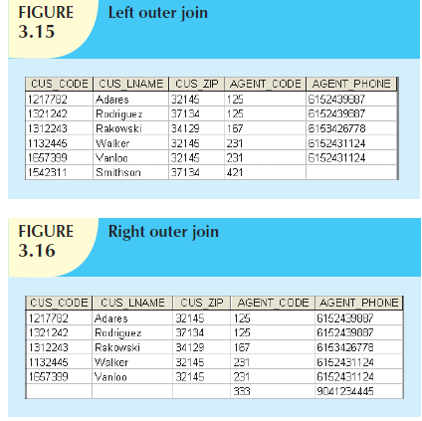

Slide 56
Generally speaking, outer joins operate like equijoins.
The outer join does not drop one copy of the common attribute, and it requires the specification of the join condition.
Outer joins are especially useful when you are trying to determine what value( s) in related tables cause(s) referential integrity problems.
Such problems are created when foreign key values do not match the primary key values in the related table(s).

Slide 57
In fact, if you are asked to convert large spreadsheets or other nondatabase data into relational database tables, you will discover that the outer joins save you vast amounts of time and uncounted headaches when you encounter referential integrity errors after the conversions.
You may wonder why the outer joins are labeled left and right. The labels refer to the order in which the tables are listed in the SQL command.

Slide 58
The DIVIDE operation uses one single-column table (e.g., column “a”) as the divisor and one 2-column table (i.e., columns “a” and “b”) as the dividend. The tables must have a common column (e.g., column “a”).
The output of the DIVIDE operation is a single column with the values of column “a” from the dividend table rows where the value of the common column (i.e., column “a”) in both tables matches

Slide 59
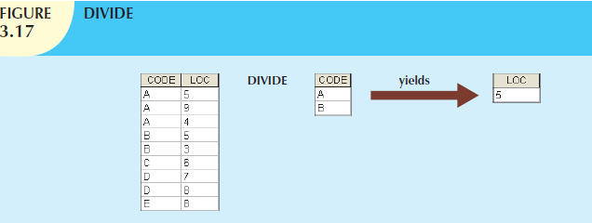

Slide 60
Using the example shown in Figure 3.17, note that:
  a. Table 1 is “divided” by Table 2 to produce Table 3. Tables 1 and 2 both contain the column CODE but do not share LOC.
  b. To be included in the resulting Table 3, a value in the unshared column (LOC) must be associated (in the dividing Table 2) with every value in Table 1.
  c. The only value associated with both A and B is 5.

Slide 61
THE DATA DICTIONARY AND THE SYSTEM CATALOG
The data dictionary provides a detailed description of all tables found within the user/designer-created database.
Thus, the data dictionary contains at least all of the attribute names and characteristics for each table in the system.
In short, the data dictionary contains metadata—data about data.

Slide 62
Note
The data dictionary in Table 3.6 is an example of the human view of the entities, attributes, and relationships.
The purpose of this data dictionary is to ensure that all members of database design and implementation teams use the same table and attribute names and characteristics.
The DBMS’s internally stored data dictionary contains additional information about relationship types, entity and referential integrity checks and enforcement, and index types and components.
This additional information is generated during the database implementation stage.

Slide 63
THE DATA DICTIONARY AND THE SYSTEM CATALOG
The data dictionary is sometimes described as “the database designer’s database” because it records the design decisions about tables and their structures.
Like the data dictionary, the system catalog contains metadata.
The system catalog can be described as a detailed system data dictionary that describes all objects within the database, including data about table names, the table’s creator and creation date, the number of columns in each table, the data type corresponding to each column, index filenames, index creators, authorized users, and access privileges.

Slide 64
Because the system catalog contains all required data dictionary information, the terms system catalog and data dictionary are often used interchangeably.
In fact, current relational database software generally provides only a system catalog, from which the designer’s data dictionary information may be derived.
The system catalog is actually a system-created database whose tables store the user/designer-created database characteristics and contents.
Therefore, the system catalog tables can be queried just like any user/designer-created table.

Slide 65
In effect, the system catalog automatically produces database documentation.
As new tables are added to the database, that documentation also allows the RDBMS to check for and eliminate homonyms and synonyms.
In general terms, homonyms are similar-sounding words with different meanings, such as boar and bore, or identically spelled words with different meanings, such as fair (meaning “just”) and fair (meaning “festival”).
In a database context, the word homonym indicates the use of the same attribute name to label different attributes.
For example, you might use C_NAME to label a customer name attribute in a CUSTOMER table and also use C_NAME to label a consultant name attribute in a CONSULTANT table.
To lessen confusion, you should avoid database homonyms; the data dictionary is very useful in this regard.

Slide 66
In a database context, a synonym is the opposite of a homonym and indicates the use of different names to describe the same attribute.
For example, car and auto refer to the same object.
Synonyms must be avoided.

Slide 67
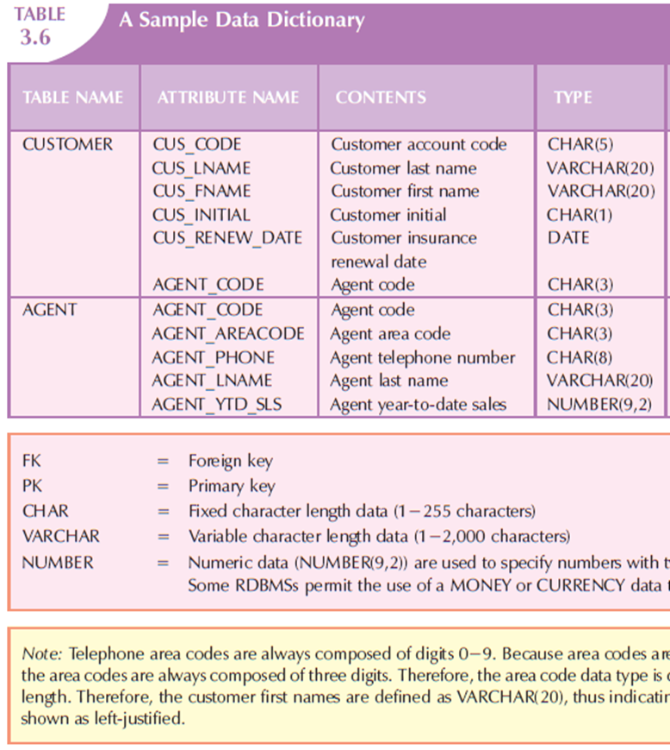
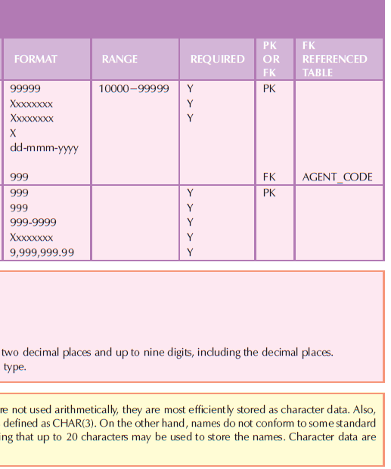

Slide 68
RELATIONSHIPS WITHIN THE RELATIONAL DATABASE
You already know that relationships are classified as one-to-one (1:1), one-to-many (1:M), and many-to-many (M:N or M:M).
This section explores those relationships further to help you apply them properly when you start developing database designs, focusing on the following points:
  The 1:M relationship is the relational modeling ideal. Therefore, this relationship type should be the norm in any relational database design.
  The 1:1 relationship should be rare in any relational database design.
  M:N relationships cannot be implemented as such in the relational model. Later in this section, you will see how any M:N relationship can be changed into two 1:M relationships.

Slide 69
The M:N Relationship
A many-to-many (M:N) relationship is not supported directly in the relational environment.
However, M:N relationships can be implemented by creating a new entity in 1:M relationships with the original entities.
To explore the many-to-many (M:N) relationship, consider a rather typical college environment in which each STUDENT can take many CLASSes, and each CLASS can contain many STUDENTs.
The ER model in Figure 3.24 shows this M:N relationship.

Slide 70
Given such a data relationship and the sample data in Table 3.7, you could wrongly assume that you could implement this M:N relationship by simply adding a foreign key in the many side of the relationship that points to the primary key of the related table

Slide 71
However, the M:N relationship should not be implemented as shown in Figure 3.25 for two good reasons:
The tables create many redundancies. For example, note that the STU_NUM values occur many times in the STUDENT table. In a real-world situation, additional student attributes such as address, classification, major, and home phone would also be contained in the STUDENT table, and each of those attribute values would be repeated in each of the records shown here. Similarly, the CLASS table contains many duplications: each student taking the class generates a CLASS record. The problem would be even worse if the CLASS table included such attributes as credit hours and course description. Those redundancies lead to the anomalies.
Given the structure and contents of the two tables, the relational operations become very complex and are likely to lead to system efficiency errors and output errors.

Slide 72
Fortunately, the problems inherent in the many-to-many (M:N) relationship can easily be avoided by creating a composite entity (also referred to as a bridge entity or an associative entity).
Because such a table is used to link the tables that were originally related in an M:N relationship, the composite entity structure includes—as foreign keys—at least the primary keys of the tables that are to be linked.
The database designer has two main options when defining a composite table’s primary key: use the combination of those foreign keys or create a new primary key.

Slide 73
DATA REDUNDANCY
You also learned that the relational database makes it possible to control data redundancies by using common attributes that are shared by tables, called foreign keys.
The proper use of foreign keys is crucial to controlling data redundancy.
Although the use of foreign keys does not totally eliminate data redundancies, because the foreign key values can be repeated many times, the proper use of foreign keys minimizes data redundancies, thus minimizing the chance that destructive data anomalies will develop.

Slide 74
Note
The real test of redundancy is not how many copies of a given attribute are stored, but whether the elimination of an attribute will eliminate information.
Therefore, if you delete an attribute and the original information can still be generated through relational algebra, the inclusion of that attribute would be redundant.
Given that view of redundancy, proper foreign keys are clearly not redundant in spite of their multiple occurrences in a table.
However, even when you use this less restrictive view of redundancy, keep in mind that controlled redundancies are often designed as part of the system to ensure transaction speed and/or information requirements.
Exclusive reliance on relational algebra to produce required information may lead to elegant designs that fail the test of practicality.

Slide 75
INDEXES
Suppose you want to locate a particular book in a library.
Does it make sense to look through every book in the library until you find the one you want? Of course not; you use the library’s catalog, which is indexed by title, topic, and author.
The index (in either a manual or a computer system) points you to the book’s location, thereby making retrieval of the book a quick and simple matter.
An index is an orderly arrangement used to logically access rows in a table.

Slide 76
Indexes in the relational database environment work like the indexes described in the preceding paragraphs.
From a conceptual point of view, an index is composed of an index key and a set of pointers.
The index key is, in effect, the index’s reference point.
More formally, an index is an ordered arrangement of keys and pointers.
Each key points to the location of the data identified by the key.

Slide 77
DBMSs use indexes for many different purposes.
You just learned that an index can be used to retrieve data more efficiently.
But indexes can also be used by a DBMS to retrieve data ordered by a specific attribute or attributes.
For example, creating an index on a customer’s last name will allow you to retrieve the customer data alphabetically by the customer’s last name.
Also, an index key can be composed of one or more attributes. For example, in Figure 3.30, you can create an index on VEND_CODE and PROD_CODE to retrieve all rows in the PRODUCT table ordered by vendor, and within vendor, ordered by product.

Slide 78
Indexes play an important role in DBMSs for the implementation of primary keys.
When you define a table’s primary key, the DBMS automatically creates a unique index on the primary key column(s) you declared.
For example, when you declare CUS_CODE to be the primary key of the CUSTOMER table, the DBMS automatically creates a unique index on that attribute.
A unique index, as its name implies, is an index in which the index key can have only one pointer value (row) associated with it. (The index in Figure 3.32 is not a unique index because the PAINTER_NUM has multiple pointer values associated with it. For example, painter number 123 points to three rows—1, 2, and 4—in the PAINTING table.)

Slide 79
A table can have many indexes, but each index is associated with only one table. The index key can have multiple attributes (composite index). Creating an index is easy.

Slide 80


Slide 81
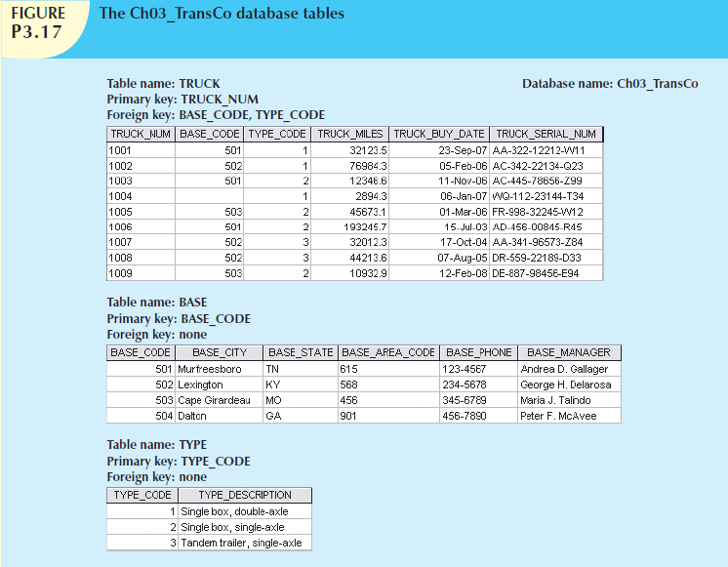
Exercise

Slide 82
For each table, identify the primary key and the foreign key(s). If a table does not have a foreign key, write None in the space provided.
Do the tables exhibit entity integrity? Answer yes or no, and then explain your answer.
Do the tables exhibit referential integrity? Answer yes or no, and then explain your answer. Write NA (Not Applicable)

Slide 83
Identify the TRUCK table’s candidate key(s).
For each table, identify a superkey and a secondary key.
Create the ERD for this database.
Create the relational diagram for this database.

