Slide 1

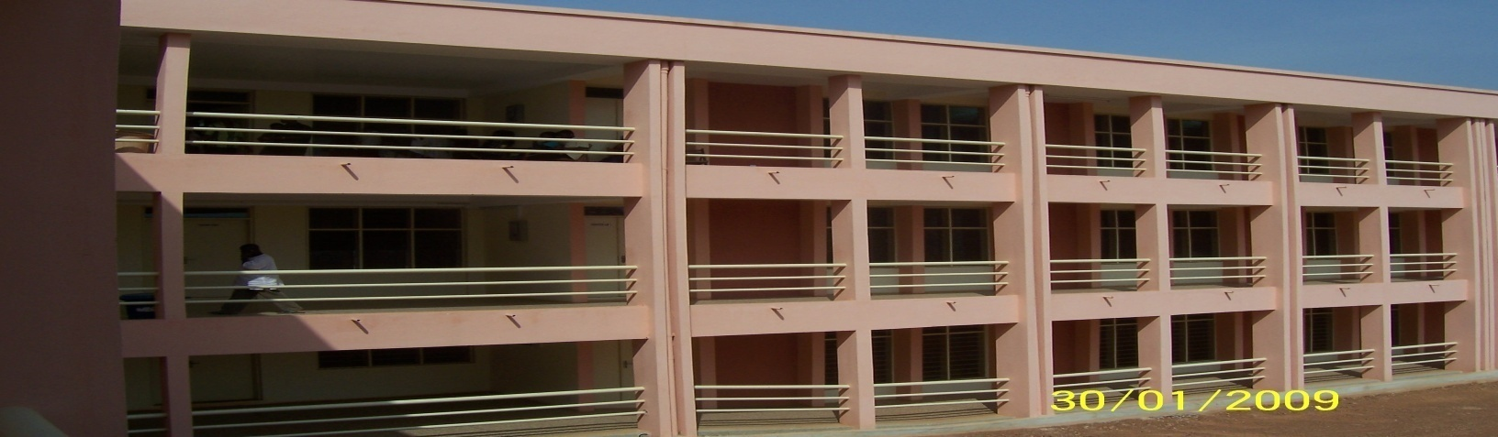

Catholic University College of Ghana
Introduction to Information Technology I
Catholic University College of Ghana
Fiapre-Sunyani

Slide 2
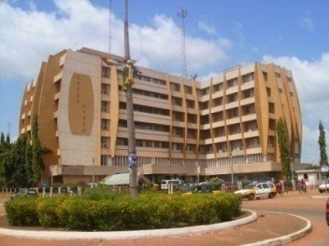
Facilitator Information
Audrey Asante
  Tutor, Faculty of Information and Communication Sciences and Technology
Email: aasante@cug.edu.gh
Telephone: 0265302718

Slide 3
Course Objectives and Learning outcomes
Upon completion of this course, students should have
  Known how to use Microsoft Excel, PowerPoint and Access
  Basic knowledge in Internet Technology

Slide 4
Study Material
Primary Source
  Brian K. Williams, Stacey C. Sawyer, Sarah E. Hutchinson (1999), Using Information Technology, 3rd Edition, McGraw
Secondary Source
  TIMOTHY J. O’LEARY, LINDA I. O’LEARY (2000), Computing Essentials 2000-2001, McGraw

Slide 5
Where do I get help?
Academic Journals (Google Scholar)
Website
Notes
Tutor
Class Discussions

Slide 6
Assessment Criteria
Continuous Assessment Mark
  2 unannounced tests - 15 marks
  (Test 1: 10 marks; Test 2: 5 marks)
  Attendance - 5 marks
  Mid-Semester - 20 marks
Examination
  Written Exam (date & time to be confirmed)
Final Mark
  40% of Continuous Assessment Mark + 60% Examination Mark

Slide 7
Questions & Feedback?
My Expectations
  Interactive & lively classes

Slide 8
List of Topics
Microsoft Excel
Microsoft PowerPoint
Microsoft Access
Internet
  Hand on experience on website and pages, Web browsers and browsing examples of websites and services

