Slide 1

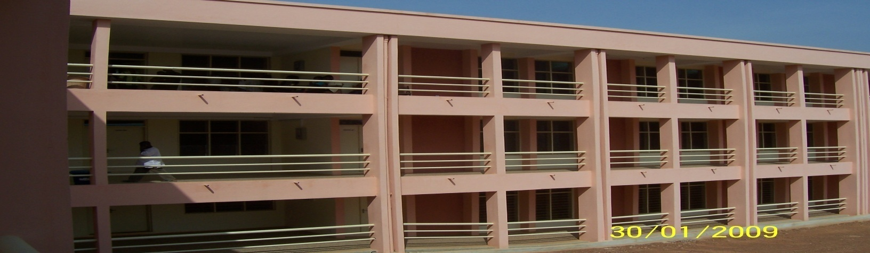

Catholic University College of Ghana
Introduction to Information Technology I
Catholic University College of Ghana
Fiapre-Sunyani

Slide 2
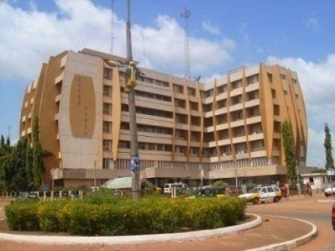
Facilitator Information
Audrey Asante
  Tutor, Faculty of Information and Communication Sciences and Technology
Email: aasante@cug.edu.gh
Telephone: 0265302718

Slide 3
Course Objectives and Learning outcomes
Upon completion of this course, students should have
  Known the concepts behind information technology
  Understood the benefits gained through the use of information technology
  Known the difference between the computer technology and communication technology and also the future trends.
  Known the difference between hardware and software
  Basic knowledge in data communications and networks

Slide 4
Study Material
Primary Source
  Brian K. Williams, Stacey C. Sawyer, Sarah E. Hutchinson (1999), Using Information Technology, 3rd Edition, McGraw
Secondary Source
  TIMOTHY J. O’LEARY, LINDA I. O’LEARY (2000), Computing Essentials 2000-2001, McGraw

Slide 5
Where do I get help?
Academic Journals (Google Scholar)
Website
Notes
Tutor
Class Discussions

Slide 6
Assessment Criteria
Continuous Assessment Mark
  Group Sessions
  Presentations
  Group Assignments
  Individual Assignments
  Mid-semester Examination
  Unannounced tests
  A required minimum of 50% to write the exam
Examination
  Written Exam (date & time to be confirmed)
Final Mark
  50% of Continuous Assessment Mark + 50% Examination Mark

Slide 7
Questions & Feedback?
My Expectations
  Interactive & lively classes

Slide 8
Rules and Regulations
All students should be seated even if the facilitator has not arrived
No student will be allowed to go out unless it is emergency.
All mobile phones should be switched off during lecture period. Any phone seized will remain with the tutor for the rest of the semester (not negotiable).
Students should prepare by reading before coming for lectures
Indiscipline will not be tolerated in the class
Students should be decently dressed
Permission to absent yourself from class should be asked a day before the meeting day.
A student who wants to leave the class whiles lectures is going on should ask permission

Slide 9
List of Topics
An introduction to Information Technology
  Information Technology
  Computer and Communication Technology
  Elements of Computer-Communication System
  Difference between Analog and Digital data
Data and Information
  Definition of Data/Information
  Units of Measurement
Basic Operations of Computing
Hardware Categories

Slide 10
List of Topics
Three Directions of Computer Development
Five Kinds of Computers
Software
  Application Software
  System Software
Input Devices
  Keyboard
    Features of the Keyboard
    Keyboard Keys
  Mouse
User Interface
  Graphic User Interface (GUI)
Tutorials and Documentation

Slide 11
List of Topics
Hardware
  Mother Board
  CPU
  Memory
  Bus Lines
  Boards and Slots
  Ports
  Printers
  Storage Devices
  Interfaces
  Graphics and Sound Systems

Slide 12
List of Topics
Data Protection and Security
  Data Protection
  Data Security
  Computer Viruses
  Computers and Law
Networks
  Network Types
  Advantages of Networks
  Types of LAN
  Component of LAN
  LAN Topologies

Slide 13
List of Topics
Computers and Society
  Information Society
  Chances and Risk
Microsoft Word

